Slide 1
Development of a Crop Wild Relative Conservation Strategy for Mexico
Aremi R. Contreras Toledo
Supervisors:
Moisés Cortés, National Genetic Resources Center (CNRG-INIFAP), Mexico
Denise Costich, Maize Germplasm Bank, CIMMYT, Mexico
Ma. de Lourdes Rico Arce, Royal Botanic Gardens, Kew, UK
Joana Magos Brehm, University of Birmingham, UK
Nigel Maxted, University of Birmingham,UK
Birmingham, 2nd June, 2016

Slide 2
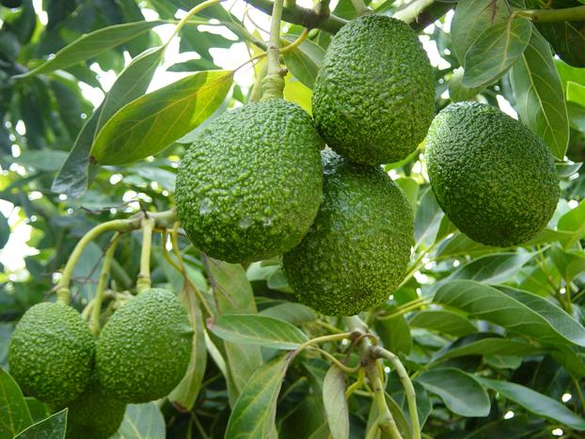
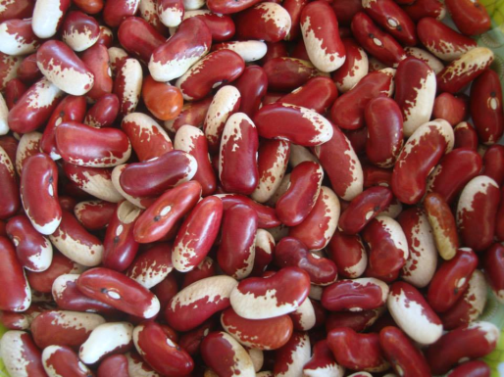
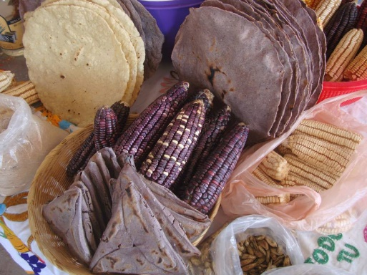
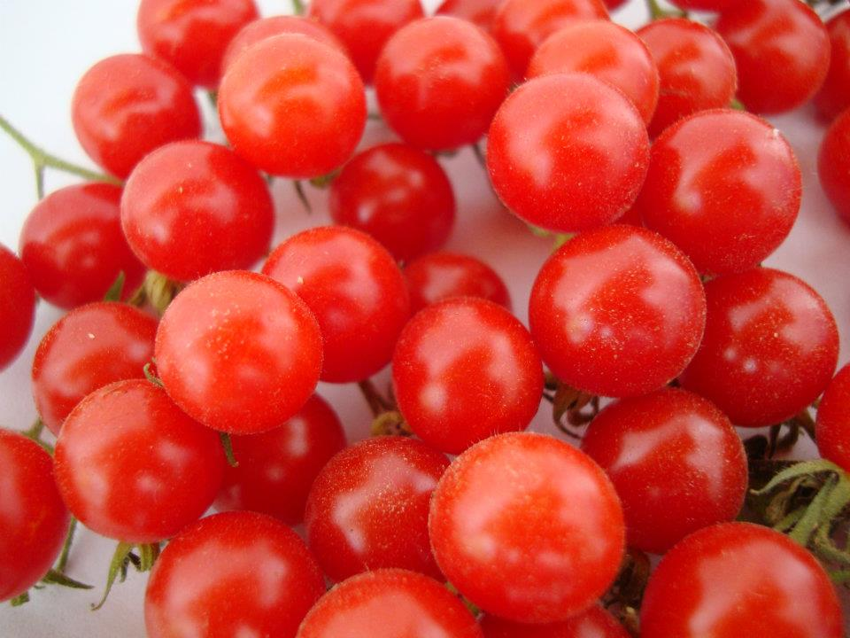
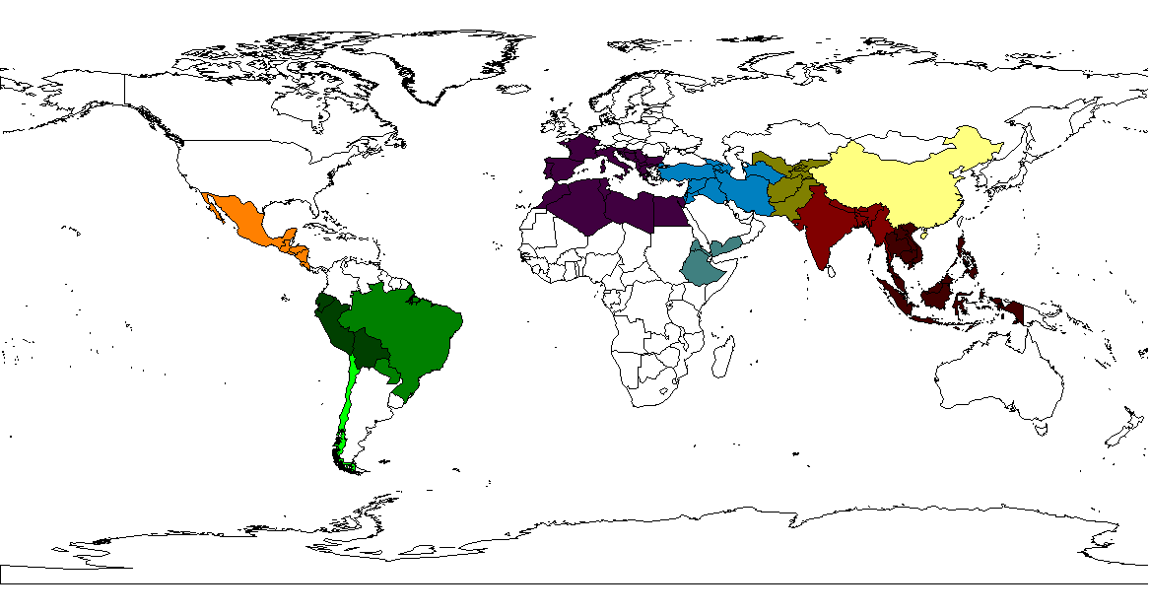
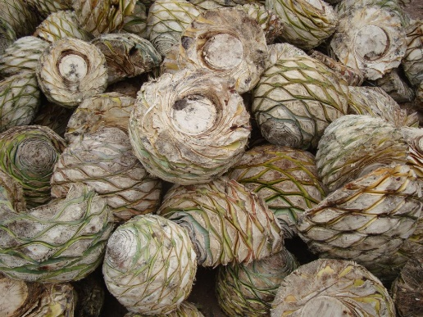
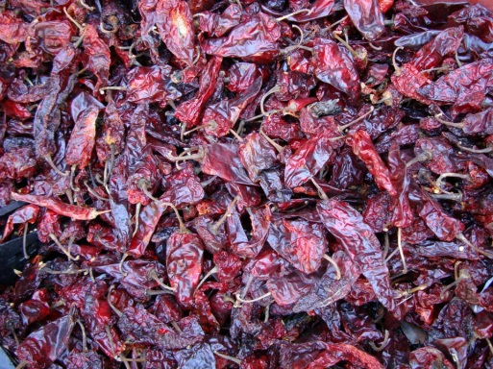
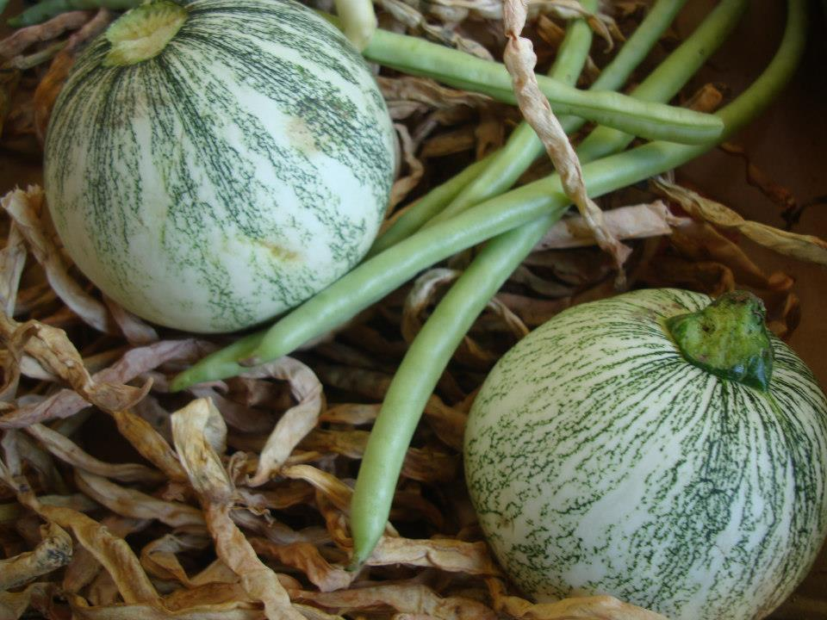
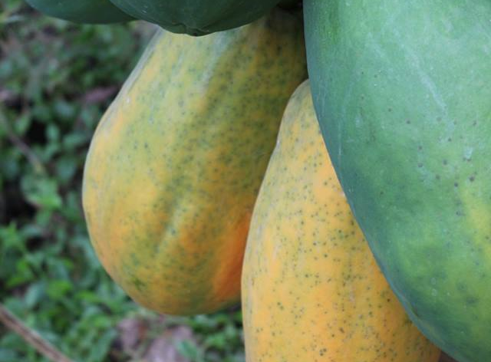
V
IV
III
I
VII
IIa
VI
IIb
VIII
VIIIb
VIIIa

Slide 3
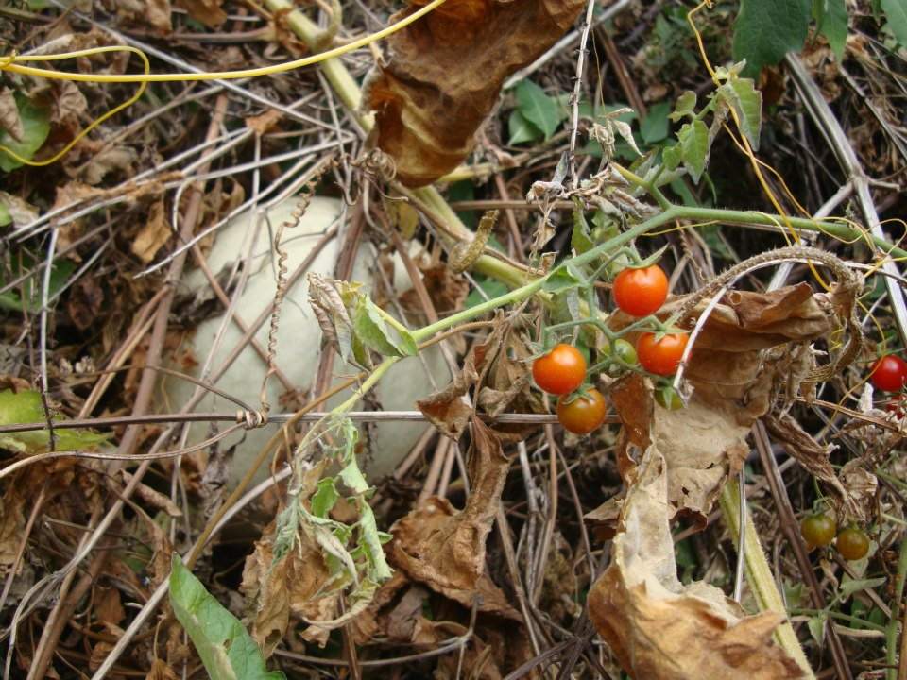
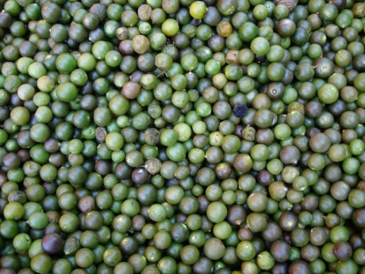
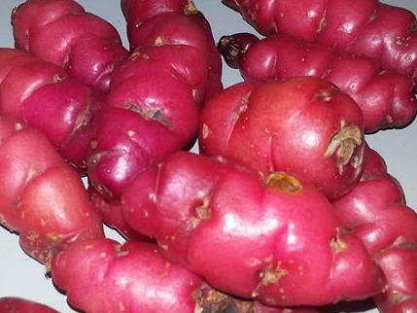
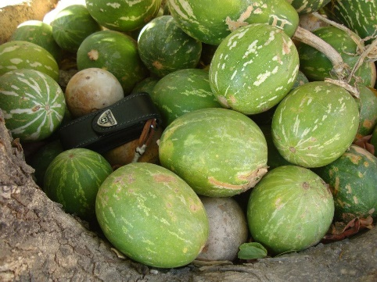
CWR: Value
CROP | CWR | USE | Source
Pepper Capsicum annuum | C. frutescens | Yield improvement | Rao et al., 2013
Sunflower Helianthus annuus | H. paradoxus | Salt tolerance | Lexer et al., 2014
Sweet potato Ipomoea batatas | I. trifida | Nematode resistance | Sakamoto, 1976
Tomato Lycopersicon esculentum | L. hirsutum | Processing ability improvement | Tanksley et al., 1996; Bernacchi et al., 1998
Common bean Phaseolus vulgaris | P. vulgaris var. aborigineus | Yield improvement | Blair et al., 2003, Blari et al., 2006
Maize Zea mays | Z. diploperennis | Tillering improvement | Sondahl et al., 1984

Slide 4
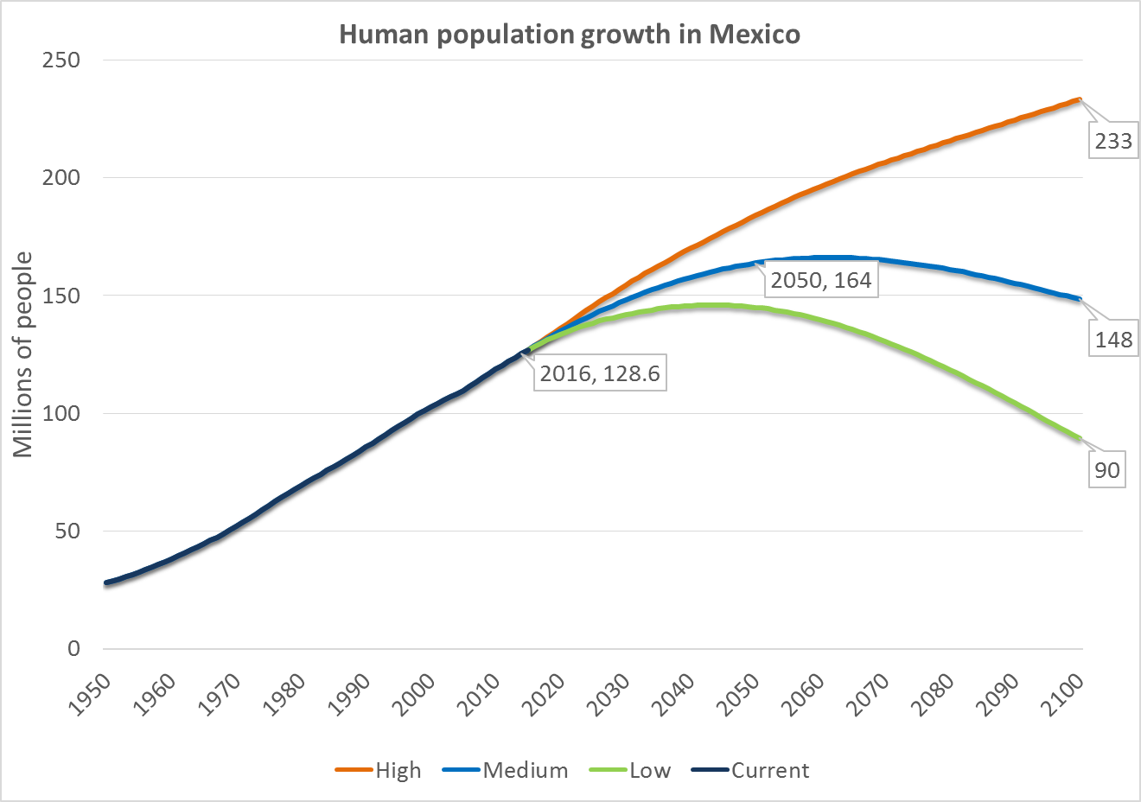
Threats: Human population growth
Data from http://esa.un.org/unpd/wpp/

Slide 5
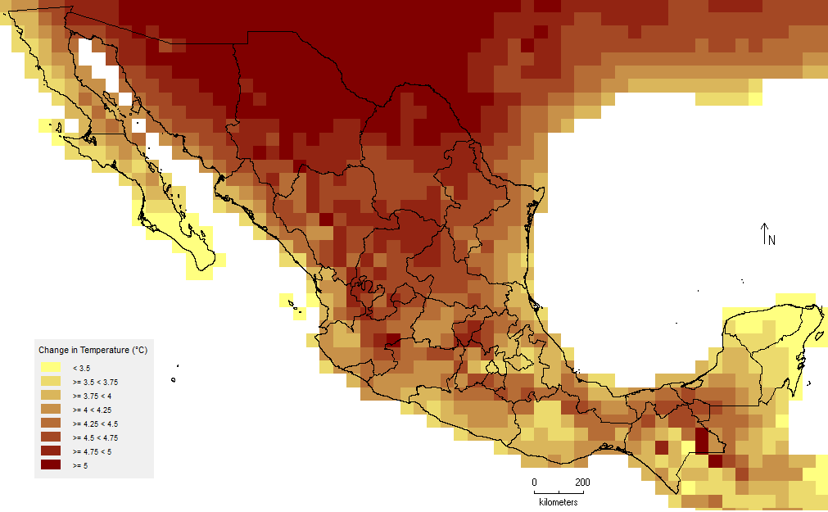
Threats: Climate Change
Change in Annual Mean Temperature in Mexico under RCP8.5 Scenario (2075-2099)
Data from www.inecc.gob.mx

Slide 6
Objectives
To develop a national CWR conservation strategy for the systematic active long-term conservation of Mexican CWR
I. Creation of a National CWR Inventory
II. Gap Analysis
III. Threat Assessments
IV. Climate Change Impacts
V. Predictive Characterization

Slide 7
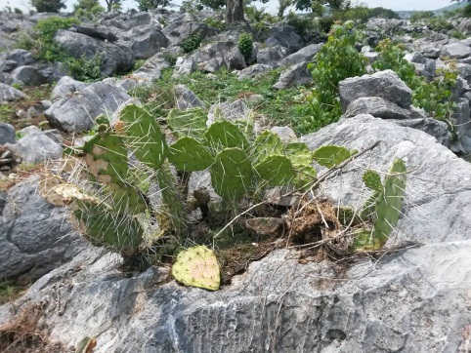
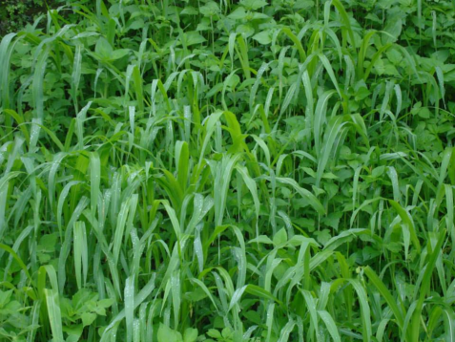
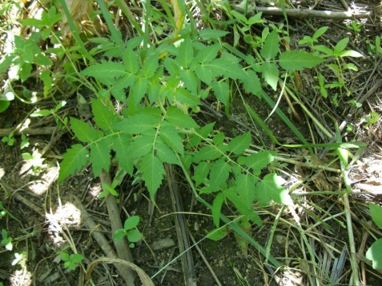
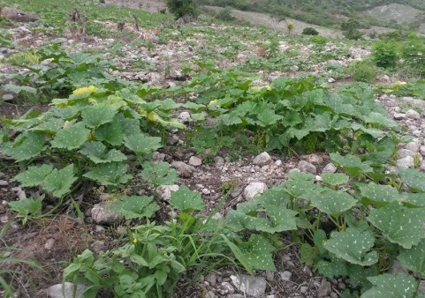
I. Creation of a National CWR Inventory
  Prioritized List of Mexican CWR: taxonomic, potential use, etc.
  Prioritization criteria: geographical distribution, threat status, socio-economic values of the related crops and the level of relationship to the crop
  Identified 313 CWR taxa as a priority
  33 families and 51 genera. Related to cereal, vegetable, legume, fruit, tuber, forage, spice and industrial native crops

Slide 8
II. Gap Analysis
  An assessment to detect gaps in the representativeness of the germplasm in ex situ or in situ conservation
  Identify underrepresented taxa and geographic areas or environments for in situ and ex situ conservation
  Comparison between the natural range of the species and the diversity currently conserved – GIS and Species distribution modeling tools

Slide 9
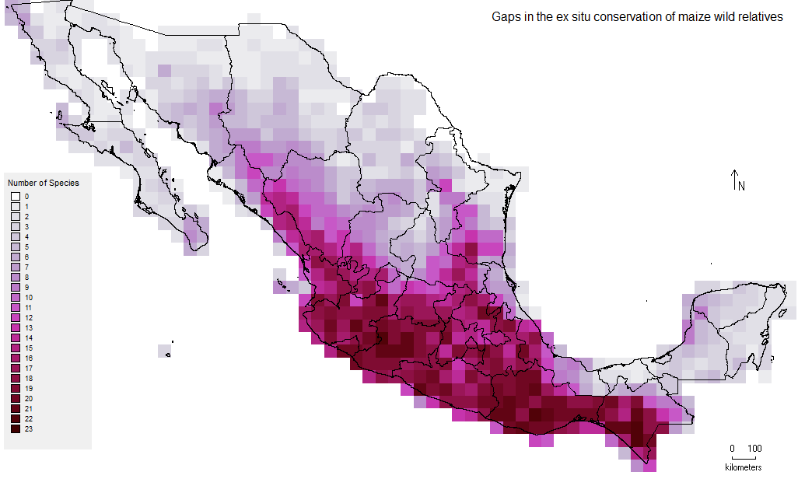
II. Gap Analysis
Ex situ Gap Analysis
Gaps in the ex situ conservation of maize wild relatives (Zea spp. and Tripsacum spp.) in Mexico. The darkest red cells show the suitable areas where the 23 species are likely to occur, but further ex situ conservation is needed. Cell size is 0.5 degrees (60 x 60 km).

Slide 10
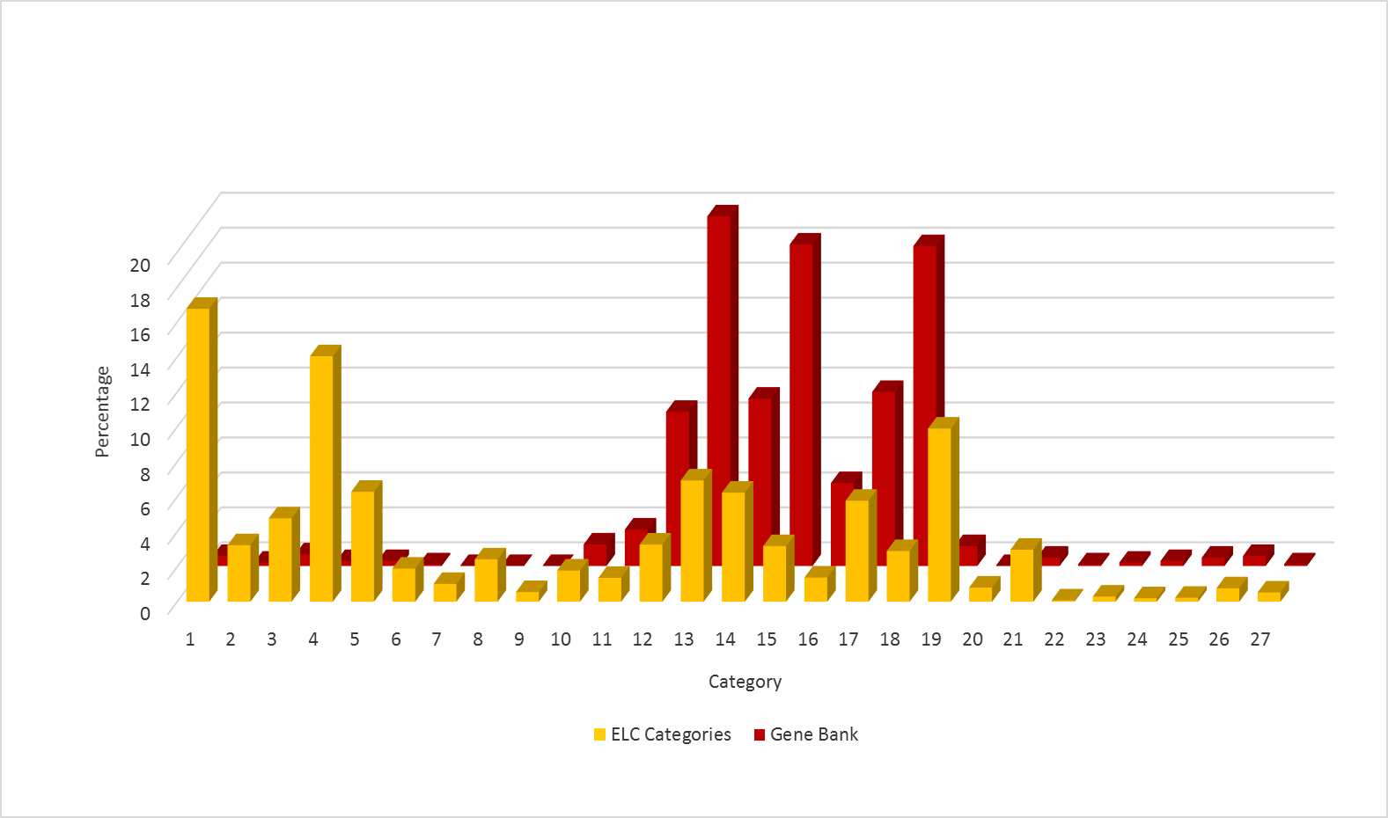
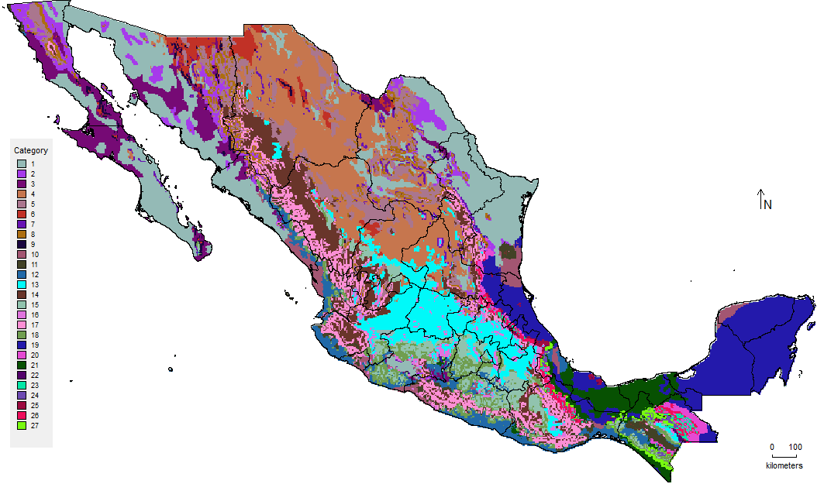
II. Gap Analysis
Ecogeographic Gap Analysis
B
A
Ecogeographic gap analysis of maize wild relatives (Zea spp. and Tripsacum spp.) in Mexico. A) Ecogeographic Land Characterization (ELC) map showing the 27 categories. B) Percentage of coverage of each category and the representation of the categories in the ex situ collections.

Slide 11
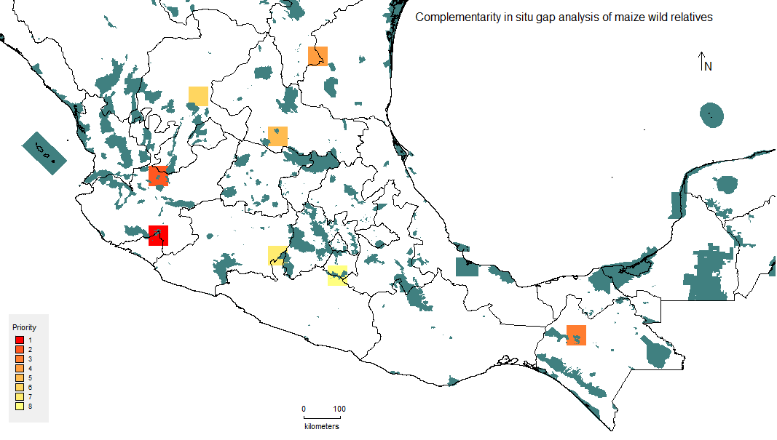
II. Gap Analysis
In situ Gap Analysis
Priority In situ conservation sites for maize wild relatives (Zea spp. and Tripsacum spp.) in Mexico. The number of the grid indicates the priority of the site, being 1 the highest priority. Shaded regions indicate protected areas. Cell size is 0.5 degrees (60 x 60 km).

Slide 12
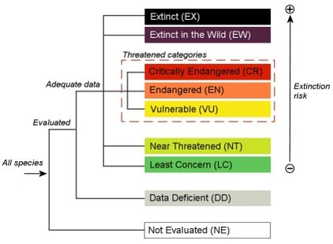
III. Threat Assessment
  Assess the extinction risk of CWR in Mexico, based on the IUCN Red List threat assessment methodologies, to produce information that complements the prioritization process and conservation strategy.
http://www.iucnredlist.org/

Slide 13
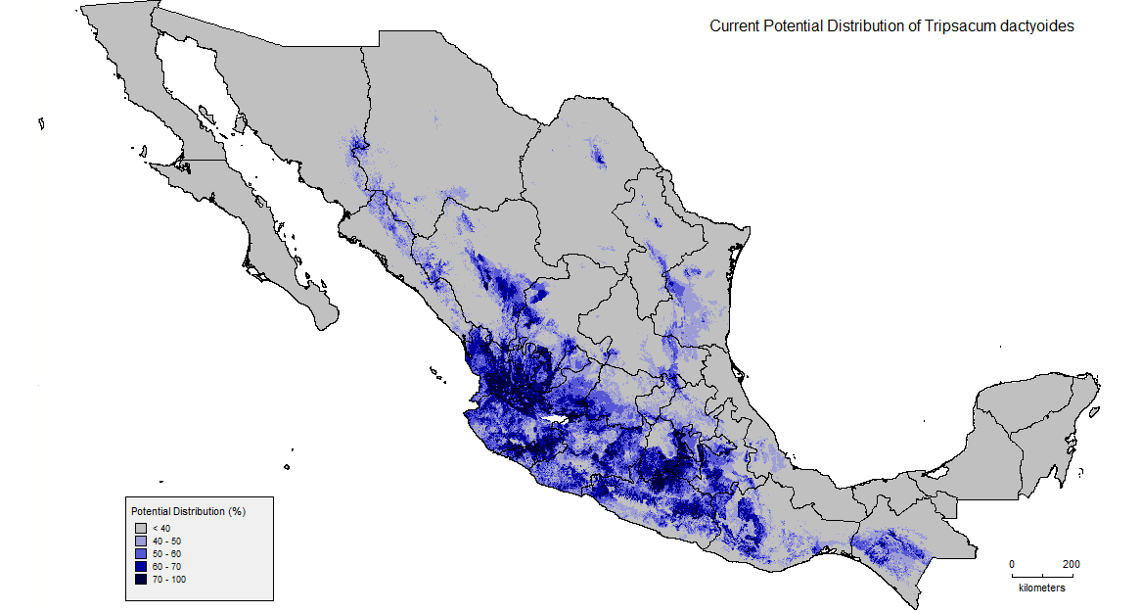
IV. Impacts of Climate Change
  Analyze the impact of climate change effects on current and future potential distribution patterns and diversity of priority CWR taxa under several scenarios of climate change (PCR2.6, RCP4.5, PCR6.0, RCP8.5)

Slide 14
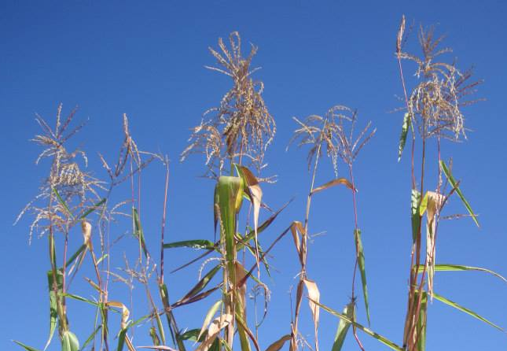
V. Predictive Characterization
  To identify accessions or populations that are likely to present adaptive traits
  Ecogeographical Filtering Method: Analyze the relationship between the eco-geographic variables (bioclimatic, edaphic or geophisical) associated to the traits of interest and the geographic distribution of the CWR

Slide 15
Conclusions
Priority sites will be identified throughout the country for to ensure the complementary in situ and ex situ conservation of priority CWR
CWR accessions will be selected for their potential utilization in crop breeding
The national CWR conservation strategy will help establish a systematic long term conservation of these genetic resources

Slide 16
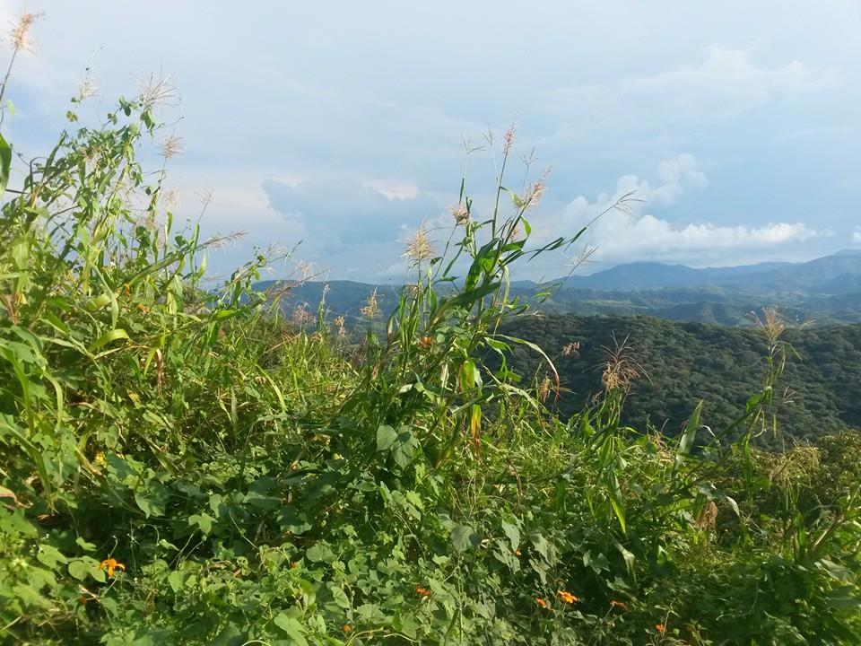
Thank you!
Photos by Hernandez G. C. del A.
Aremi R. Contreras Toledo, arc382@bham.ac.uk
Moisés A. Cortés Cruz, National Genetic Resources Center (CNRG-INIFAP), Mexico
Denise Costich, Maize Germplasm Bank, CIMMYT, Mexico
Ma. de Lourdes Rico Arce, Royal Botanic Gardens, Kew, UK
Joana Magos Brehm, University of Birmingham, UK
Nigel Maxted, University of Birmingham,UK

