Slide 1
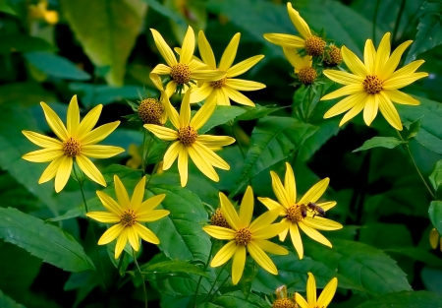


Global in situ conservation analysis of CWR
Holly Vincent, Nigel Maxted
Plant Genetic Resources: our challenges, our food, our future
2nd June 2016
The University of Birmingham,
UK

Slide 2
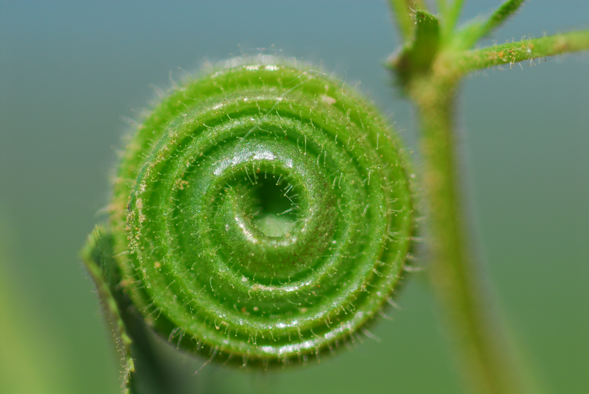
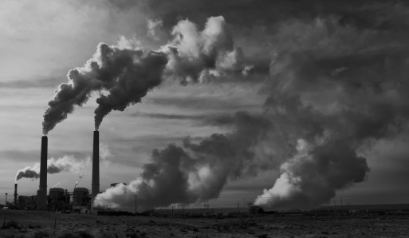
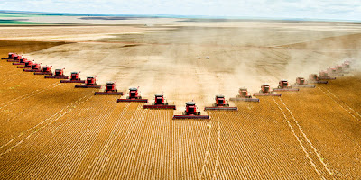

The biodiversity crisis
Currently living through the Earth’s sixth great extinction which is widely agreed to be caused by anthropogenic actions
Biodiversity underpins the ecosystem services on which we rely. Studies have found biodiversity loss can have as much impact as climate change on ecosystems and their services.
By 2100 10-30% of species globally could be at risk of extinction
The main drivers for biodiversity loss are demand for energy and the demand for food, which lead to deforestation, urbanisation of natural areas and climate change

Slide 3
The state of food security worldwide
Food security – “A situation that exists when all people, at all times, have physical, social and economic access to sufficient, safe and nutritious food that meets their dietary needs and food preferences for an active and healthy life”
1 in 9 people worldwide currently suffer from chronic hunger; this is likely to increase with the forecast growth in human population over coming decades.
To feed a growing population it is estimated that 70-100% more food will need to be produced in 2050
Climate change is likely to impact food security. The IPCC fifth assessment predicts that crop yield losses may reach 25% per year post 2050 if we do not adapt our crops to a changing climate.

Slide 4
Agricultural challenges
Improve current food security and reduce hunger and malnutrition
Increase food production for a projected 9.6 billion human population and a climate insecure future
Increase efficiency and use fewer natural resources
Increase tolerance of crops to pest and disease outbreaks - forecast to migrate due to climate change

Slide 5
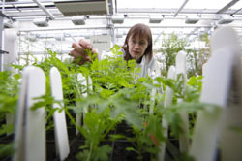
Crop wild relatives (CWR)
CWR are the wild and weedy cousins, including progenitors, of domesticated crops
CWR possess high genetic diversity compared with domesticates and contain underutilised potential for crop improvement
Breeders have called for greater access to a wider range of CWR genetic diversity to combat the agricultural challenges posed by climate change, and a growing population , leading to the inception of the project “Adapting Agriculture to Climate Change: Collecting, Protecting and Preparing Crop Wild Relatives”.

Slide 6
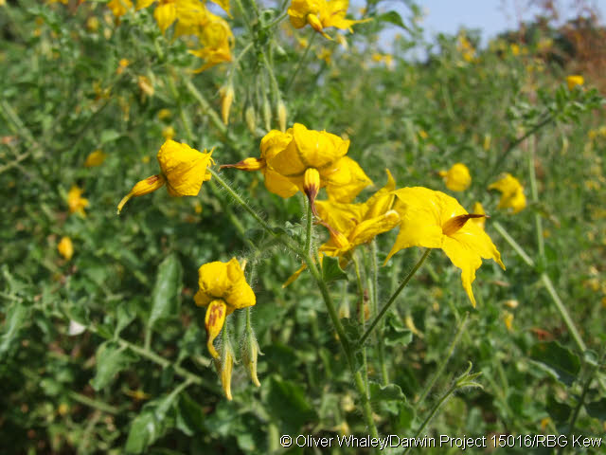
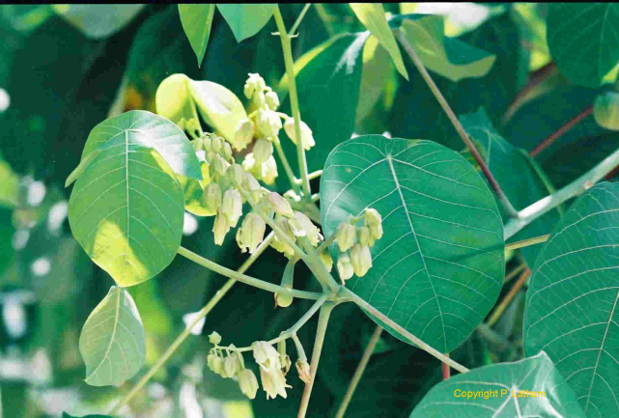

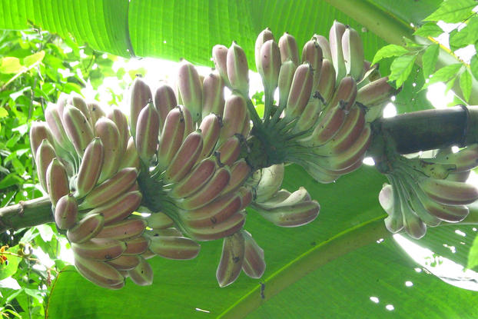
CWR utilisation
Solanum chilense (Dunal) Reiche- resistance to tomato yellow leaf curl virus
CWR are estimated to contribute genes to cultivated crops worth US $115 -196 billion per annum
Manihot glaziovii Müll. Arg.– improved cassava protein content
Musa itinerans Cheesman –water-logging resistance for banana

Slide 7
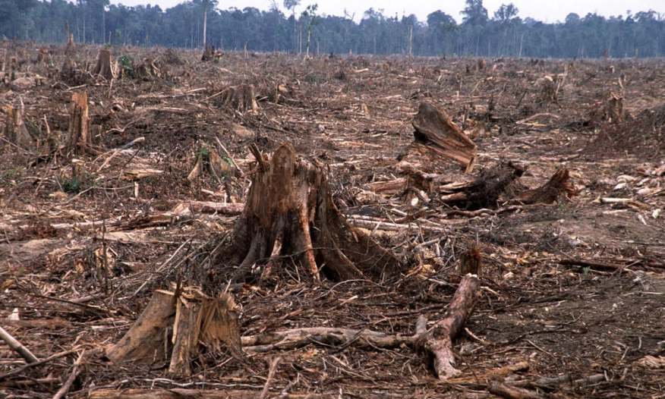
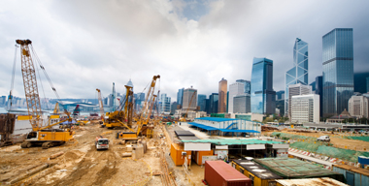
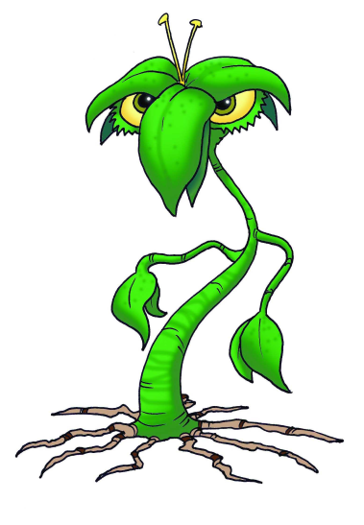
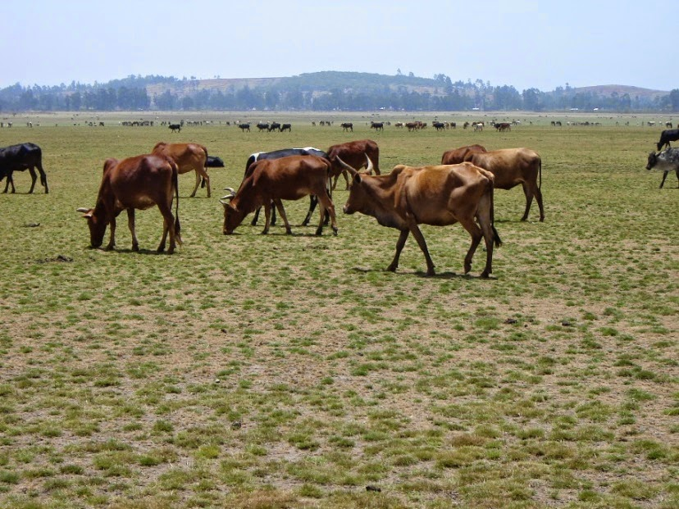
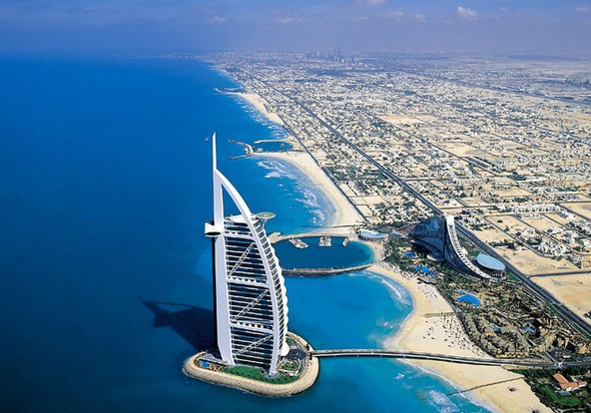
Threats to CWR

Slide 8



Policy for in situ CWR conservation
Aichi targets: Target 13
GSPC: Target 9
Second GPA: Activity 4
SDGs: Target 2

Slide 9
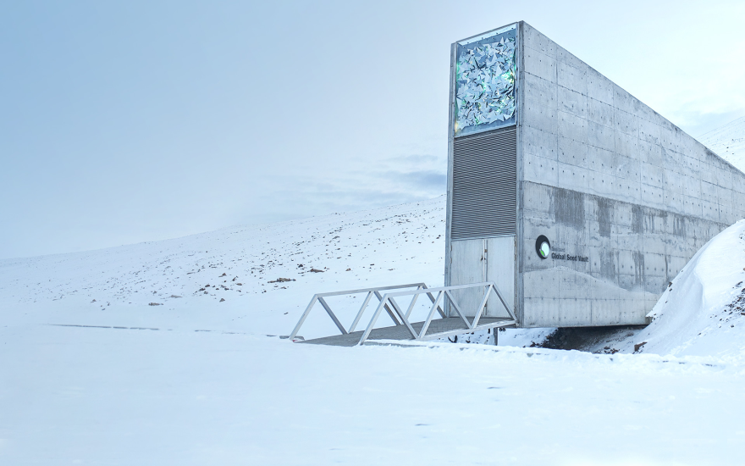
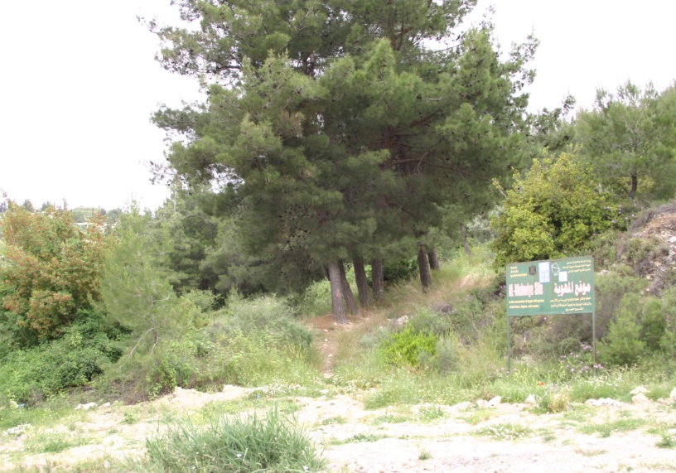
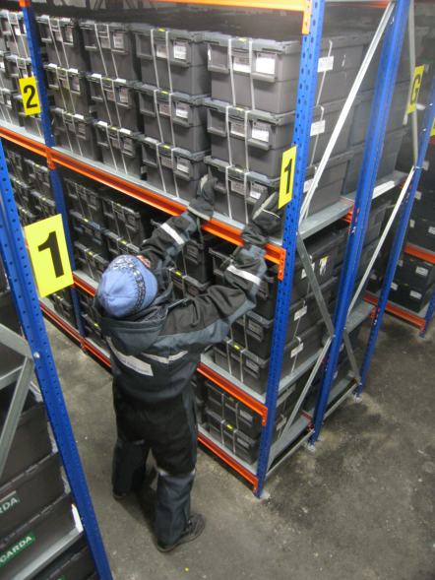
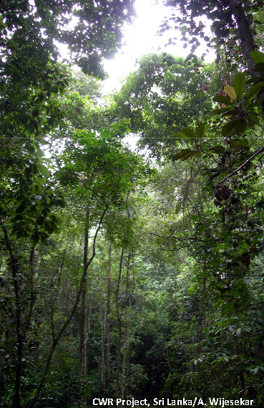
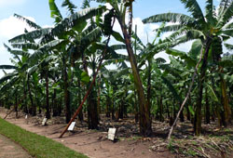
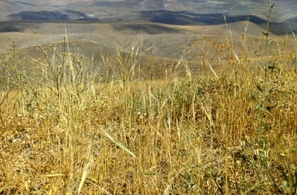
Conservation of CWR
Ex situ
In situ

Slide 10
A focus on in situ conservation
CWR are present in many PAs but not necessarily managed. Some examples of sites managed for CWR include:
Deltas del Estero Real y Llanos de Apacunca , Nicaragua – Zea nicaraguensis Iltis & Benz
Villavicencio Natural Reserve, Argentina – potato CWR
  Ceylanpinar of South-east Turkey- wheat CWR
  However, most of these sites do not meet the CWR genetic reserve standards set out by Iriondo et al. (2012)

Slide 11
Protected areas (PA)
Protected areas are not totally failsafe. PADDD Tracker monitors the downscaling, downgrading and degazettement of PAs globally .
There is also concern over the increasing loss and fragmentation of unprotected habitats leading to increasingly isolated biodiversity in PAs.
15.4% of the terrestrial world covered by PAs
17% is required by 2020 (Aichi Target 11)

Slide 12
In situ CWR conservation analysis process
Select target CWR and geographical area
Gather and edit occurrence data
Species distribution modelling (SDM)
Genetic diversity assessment
Identify gaps in PA network
Reserve planning and site prioritisation

Slide 13
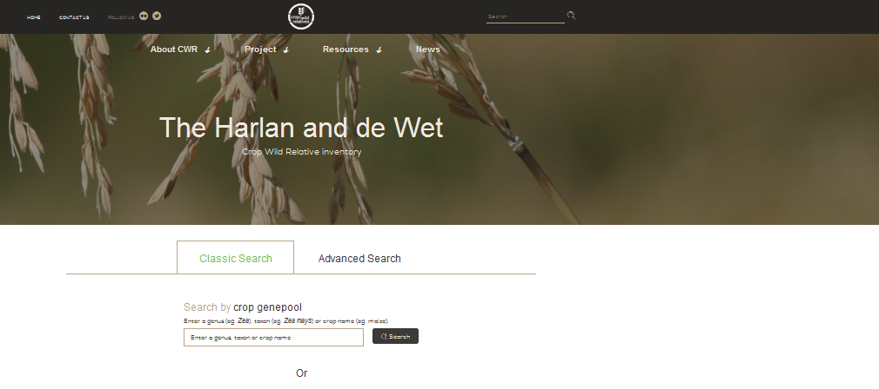
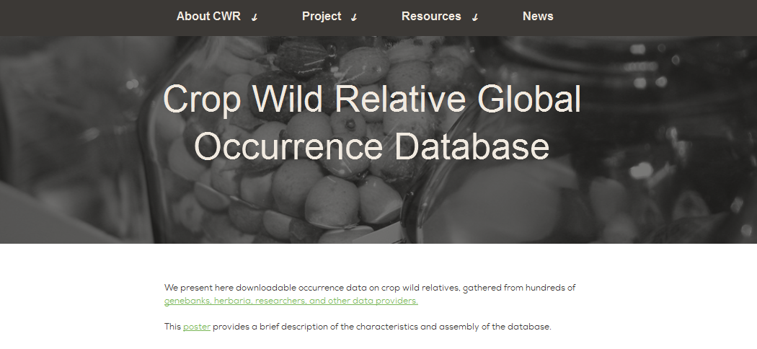
Target CWR and data collation
In total we included 185 crops and 1431 closely related CWR.
These included CWR in genepools 1B and 2; taxon groups 1B-3; and CWR with recorded known or potential use in crop breeding.
Occurrence records were edited to remove: those with no coordinate data; those with coordinates that have greater inaccuracy than 10 km; cultivated records; and records that occur outside CWR native area. In total 334,527 occurrences were utilised.

Slide 14
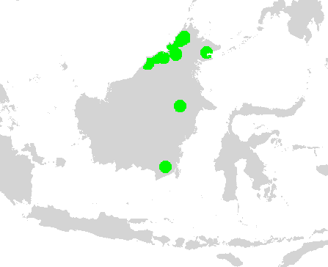
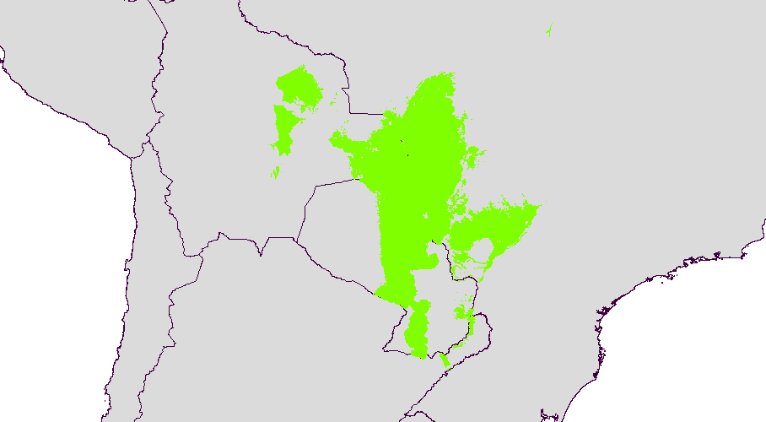
SDMs: current climate
Species with >10 unique occurrence records
Species with < 10
unique occurrence records
Geophysical variables
Climatic variables
Edaphic variables
Variance inflation factor analysis to reduce input variables
50 km buffer around each occurrence record
MaxEnt modelling, validation and thresholding

Slide 15
SDMs: future climate
30 future climate scenarios for 2070 at RCP 4.5
Valid CWR models projected to each future scenario
Logistic outputs averaged to produce a mean MaxEnt future climate projection
Projections thresholded to produce presence/absence maps

Slide 16
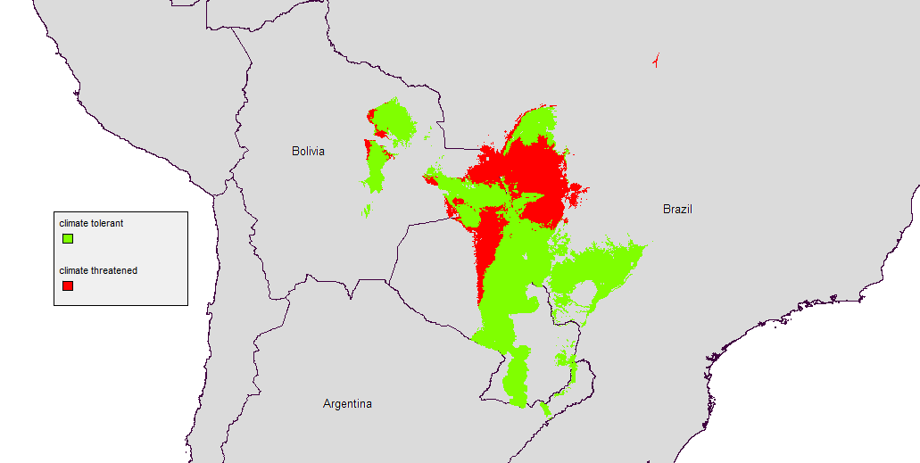
SDMs: future climate
future climate secure
future climate insecure
Notes:
Arachis diogoi

Slide 17
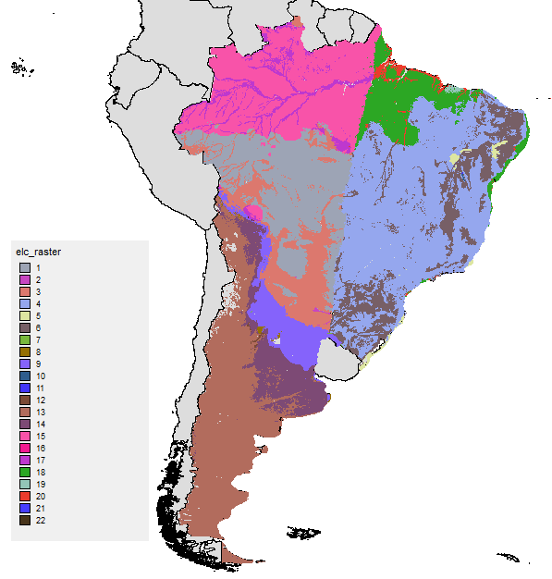
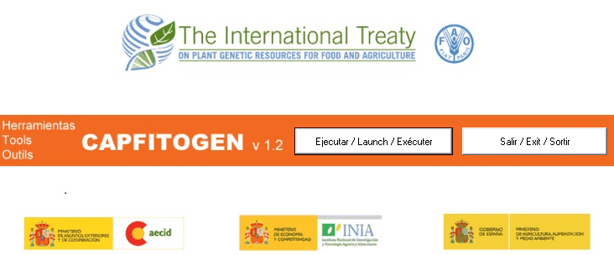
Genetic diversity assessment: environmental niche as proxy
Genetic diversity data is often lacking for individual occurrence records. Environmental adaptation can be used as a proxy for genetic diversity
Ecogeographic land characterisation (ELC) maps cluster edaphic, geophysical and bioclimatic variables then combine to qualify land into different adaptive scenarios.

Slide 18
In situ gap analysis

Slide 19
Reserve planning
Marxan is a systematic conservation planning tool which attempts to maximise biodiversity targets whilst minimising cost.
Marxan requires four input files:
planning units (pu): 5x5 arc minutes grid (~10km at the equator)
boundary: the neighbours of each planning unit
species (sp): CWR/elc niche combinations
pu versus sp: CWR/ELC niche combinations per planning unit

Slide 20
Site prioritisation
Further prioritisation of the potential reserve network produced by Marxan is required, as it is not economically feasible to conserve all sites.
We further prioritised by:
Complementarity
Valuing sites based upon economic crop values and the presence of their CWR

Slide 21

Progress
Select target CWR and geographical area
Gather and edit occurrence data
Species distribution modelling (SDM)
Genetic diversity assessment
Identify gaps in PA network
Reserve planning and site prioritisation

Slide 22
Possible future work
‘Ground truthing’ of species distributions
Contact PA managers and check for presence of CWR populations inside PAs
Addition of threat layers to the reserve planning scenario
Targeted collections of CWR undertaken by the “Adapting Agriculture to Climate Change” project can be used in future iterations of reserve planning to improve site selection. Allow more detailed modelling of species with few or no occurrence records
Biotechnology is becoming cheaper, mass sequencing of germplasm accessions could improve the targeting of populations for in situ conservation

Slide 23
Acknowledgments
This work was undertaken as part of the initiative “Adapting Agriculture to Climate Change: Collecting, Protecting and Preparing Crop Wild Relatives” which is supported by the Government of Norway.
The project is managed by the Global Crop Diversity Trust with the Millennium Seed Bank of the Royal Botanic Gardens, Kew UK and implemented in partnership with national and international genebanks and plant breeding institutes around the world.
For further information, go to the project website: http://www.cwrdiversity.org/

Slide 24
Photo credits
Slide 2: http://williegmcbride.blogspot.co.uk/2011/12/evolving-with-open-heart-and-open-mind.html; Cholla Power Plant, near Joseph City, Arizona (photo PD Tillman); sign image via: shutterstock.com
Slide 5: https://www.york.ac.uk/news-and-events/news/2010/research/artemisia/
Slide 6:Solanum chilense (Oliver Whaley); Manihot glaziovii (Paul Latham); Musa itinerans (http://www.kew.org/science-conservation/plants-fungi/musa-itinerans-yunnan-banana)
Slide 7: Logging (http://www.worldwildlife.org/threats/deforestation); invasive plants (http://powellrivergardenclubblog.blogspot.co.uk/2012/04/did-you-know-that-key-pathway-for.html); Overgrazing (IFAD/Stephen Twomlow & Will Critchley); Urban development (https://investor.deere.com/our-company/investors-relations/why-invest/default.aspx); tourism development (http://moodle.cambria.ac.uk/course/view.php?id=522)
Slide 9: http://www.reservepark.mnp.am/htmls/max_4_3.htm; http://www.cropwildrelatives.org/fileadmin/templates/cropwildrelatives.org/upload/In_situ_Manual/Chapter_summaries/In%20situ%20conservation%20%283%29%20Summary.pdf; Genetic reserve, Al-Haffe, Syria (photo: Nigel Maxted); https://www.croptrust.org/what-we-do/svalbard-global-seed-vault/; seed bank shelves (Dag Terje Filip Endresen); http://www.fao.org/agriculture/crops/thematic-sitemap/theme/seeds-pgr/gbs/en/
Backgrounds: Helianthus decapetalus L. (Kenneth Lawless)
Medicago scutellata (L.) Mill (Domenico Puntillo)

