Slide 1
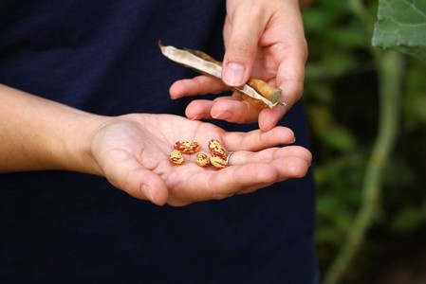
A National Strategic Action Plan for Portuguese Landraces Conservation
Maria Almeida
Supervisors:
Nigel Maxted
Joana Magos Brehm
Ana Maria Barata
Notes:
1

Slide 2
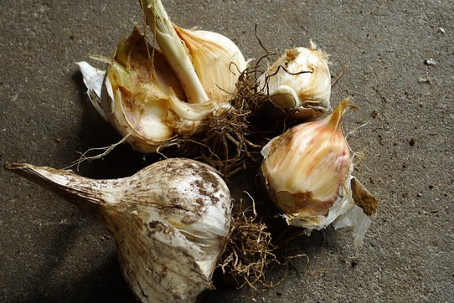
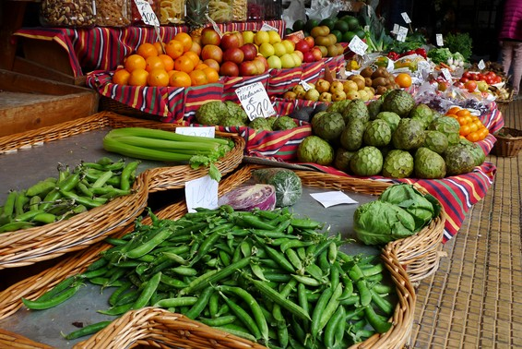
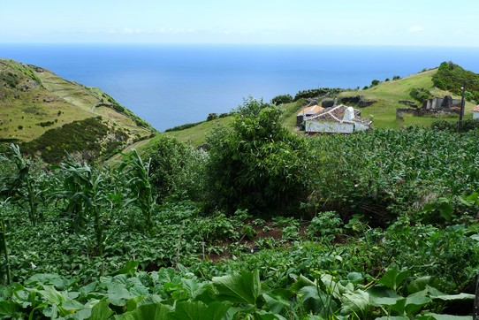
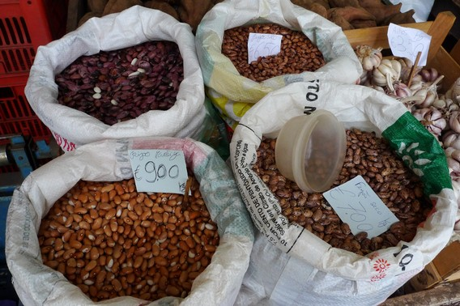
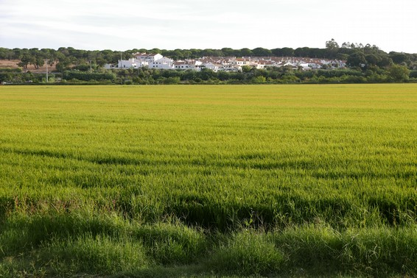
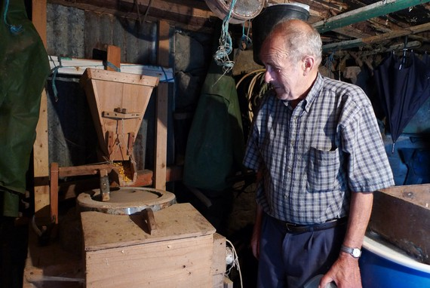
2/10
LR?
Relevance
Threats
Notes:
LR are genetically variable populations of a crop, adapted to the biotic and abiotic conditions of the area of cultivation and associated to the tradition and local knowledge
Ecologically adapted to the environments where they grow: more resilient to marginal environments, low nutrient soil, disease/stress and low-input farming systems;
Source of genes for plant breeding
The replacement by new, genetically uniform cultivars
Ageing of the farmers and unsuccessful passage of knowledge
Rural exodus
2

Slide 3
3/10
Aim
Improve Portuguese LR knowledge and secure their conservation: National Strategic Action Plan.
Notes:
3

Slide 4
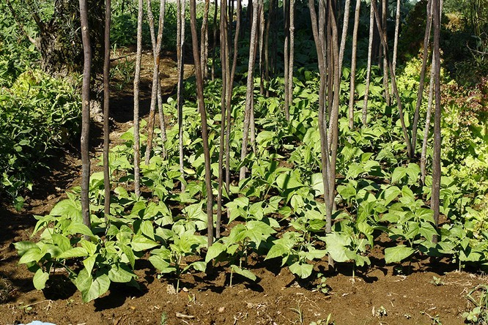
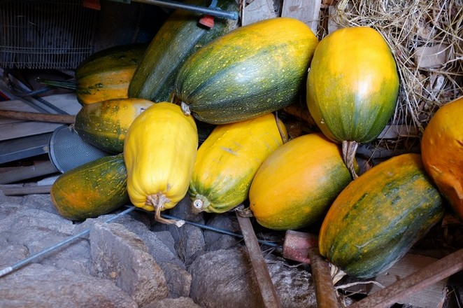
4/10
Objectives
Checklist and Inventory
Threat assessment
Gap analysis
Genetic analysis of the Phaseolus vulgaris L. (common bean) LR
Predictive characterization of resistance to extreme precipitation ranges and fungal diseases in Cucurbita pepo L. (squash) LR
Notes:
4

Slide 5
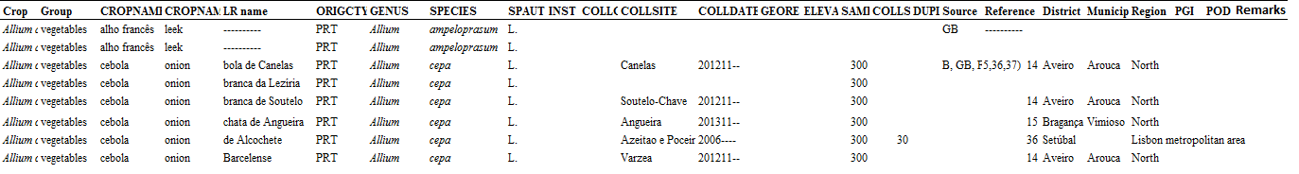
5/10
Research
Checklist and Inventory of Portuguese LR
Thus far, inventory with 92 crops and over 3000 LR names, mostly in the North part of the country
Notes:
LR checklist – list of LR names grown in Portugal
LR inventory – checklist + related information gathering and characterization of LR diversity grown in Portugal
LR information: bibliographic research + experts’ consultation + farmers` knowledge, passport data and environmental data (from a questionnaire applied in each visited site during field survey)
5

Slide 6
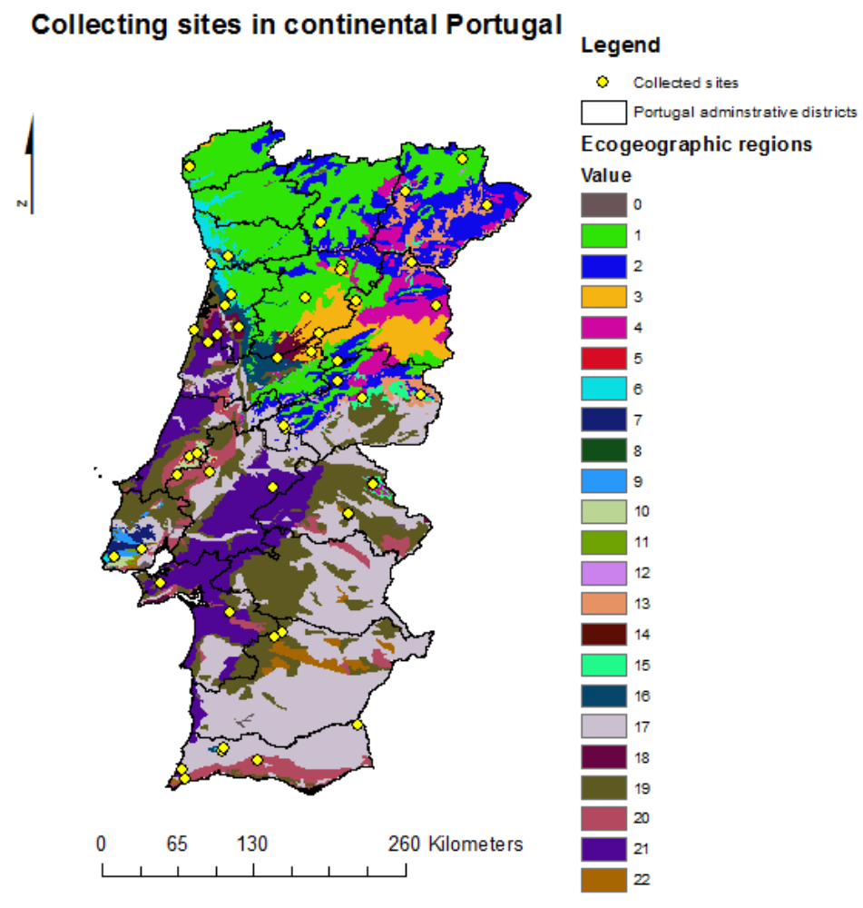
6/10
Research
Collecting sites for field survey of Portuguese LR in continental Portugal
Field survey
54 visited sites
83 collected samples of common bean LR
Notes:
Field survey – to complement bibliographic research and experts' consultation with up to date information taken from field (coordinates, altitude, farmer's knowledge and management, etc)
Ecogeographic Land Characterization (ELC) approach – use of ecogeographic information from World databases (WorldClim – Global Climate Data, etc.) and GIS (Geographic Information Systems) software to define different ecogeographic regions from where sites (ecogeographically different) were selected to survey LR from the field
6

Slide 7
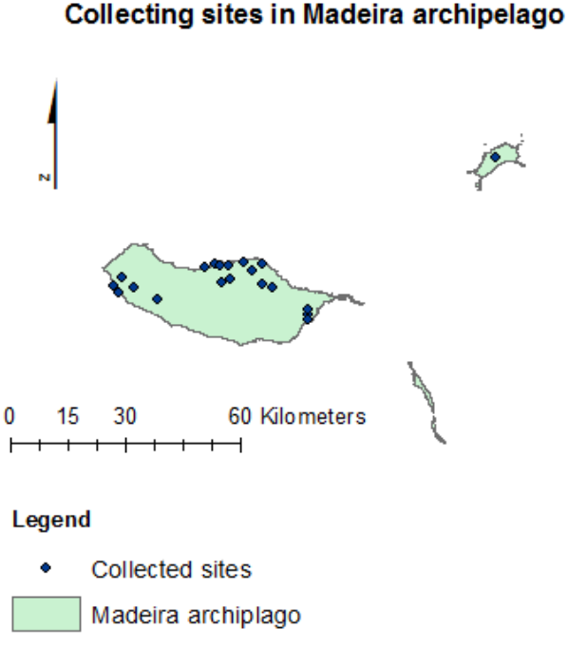
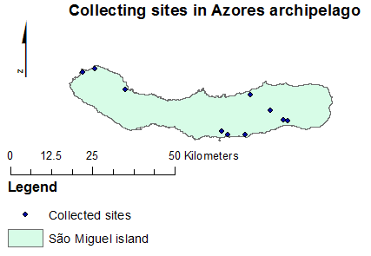
7/10
Research
Field survey
Collecting sites for field survey of Portuguese LR in Madeira archipelago
Collecting sites for field survey of Portuguese LR in Azores archipelago
22 visited sites
53 collected samples of common bean LR
89 visited sites
141 collected samples of common bean LR
Notes:
sites selected based on researcher’s knowledge of locations with LR and traditional farming methods.
7

Slide 8
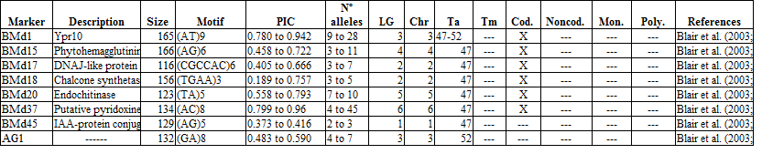
8/10
Genetic analysis
To determine genetic diversity and structure of the collected common bean LR:
• differences/similarities of the collected LR, between mainland and island LR, different ecogeographic regions.
Notes:
29 SSRs markers were selected
8

Slide 9
9/10
Future work
Threat assessment
Gap analysis
Predictive characterization of resistance to high precipitation, drought and fungal diseases in the Portuguese Gene Bank accessions of squash LR
Notes:
Threat assessment – indicate and assess the degree of threat to LR, helping to detect and prevent their genetic erosion and extinction
Gap analysis – compare the LR inventory with LR populations maintained in situ (on-farm) + maintained ex situ in gene banks and field gene banks to know the existing gaps in conservation
Predictive characterization - to select a sub-set of squash LR accessions from the Portuguese gene bank with the traits of interest, with low resources and time input
9

Slide 10
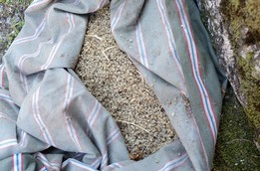
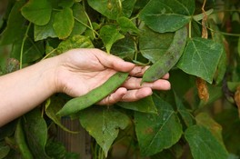
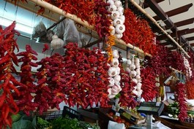
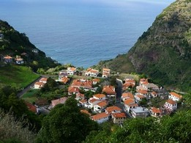
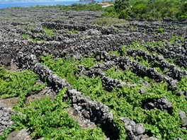
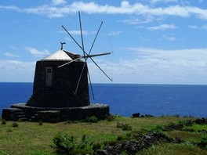
10/10
Thank you!
Notes:
10

