Slide 1
Valuing Genebank Collections
Mike Jackson
formerly International Rice Research Institute (IRRI)
the Philippines
Notes:
I AM DELIGHTED TO BE PART OF THIS ONE DAY MEETING ON PLANT GENETIC RESOURCES.
IT WAS HERE, IN THIS DEPARTMENT, WELL IN THE DEPT. OF BOTANY, 46 YEARS AGO ALMOST THAT I BEGAN MY CAREER IN GENETIC RESOURCES.
AND COMING TO BIRMINGHAM, I KNEW NOTHING ABOUT GENETIC RESOURCES, THEIR DIVERSITY, OR THEIR VALUE. IT HAD BEEN SUGGESTED TO ME AT SOUTHAMPTON THAT THIS WOULD BE AN AREA THAT I WOULD GROW INTO. THEY WEREN’T WRONG.
I WILL USE TWO CROP EXAMPLES: POTATOES AND RICE SINCE THESE ARE THE ONES WHICH I HAVE DEVELOPED A CAREER AROUND.
AND ALTHOUGH THIS ONE DAY MEETING IS ABOUT THE FUTURE, I’D LIKE TO REMINISCE FOR A FEW MINUTES ABOUT PAST DEVELOPMENTS IN GERMPLASM CONSERVATION AS A POINTER TO WHERE WE ARE TODAY.

Slide 2
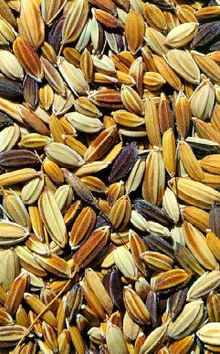
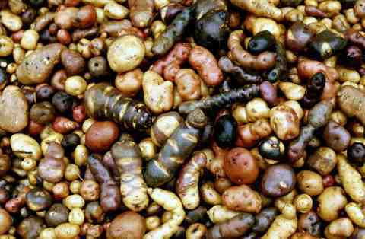
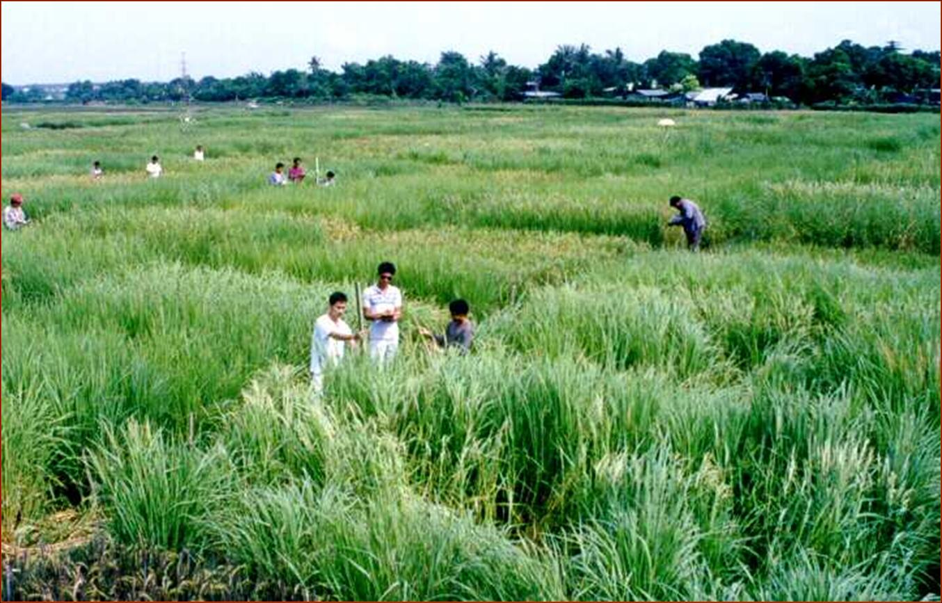
Potato
4000 varieties
Rice
>100,000 varieties
Notes:
UNTIL I BEGAN THE MSC ON PLANT GENETIC RESOURCES I HAD NO IDEA ABOUT THE RANGE OF DIVERSITY IN DIFFERENT CROPS, HOW IT HAD ORIGINATED, BEEN MANAGED BY FARMERS FOR GENERATIONS, NOR WHY IT WAS SO IMPORTANT.
NEITHER DID I APPRECIATE WHAT WAS HAPPENING TO DIVERSITY IN FARMERS’ FIELDS AT THAT TIME IN THE LATE 60S AND EARLY 70S.
THE DIVERSITY OF POTATOES HITS YOU BETWEEN THE EYES: SEVERAL ‘SPECIES’, DIFFERENT PLOIDY LEVELS, WIDE GEOGRAPHICAL AND ALTITUDE RANGE. BASIS OF AGRICULTURE IN THE ANDES.
IN RICE ON THE OTHER HAND, DIVERSITY IS MUCH MORE SUBTLE.
DIVERSITY IN SHAPE, SIZE AND COLOUR OF SEEDS. LOTS OF MORPHOLOGICAL AND PHYSIOLOGICAL VARIATION THAT CAN BE SEEN IN THESE CHARACTERIZATION PLOTS IN THE FIELDS AT IRRI.

Slide 3
Comparatively few people however, are moved to action or financial contribution by the idea of economically important plant genes disappearing from the face of the earth . . .
. . . plant genetic resources make little impression on the heart even though their disappearance could herald famine on a greater scale than ever seen before, leading to ultimate world-wide disaster.
Brian Ford-Lloyd and Mike Jackson, 1986
Notes:
BRIAN FORD-LLOYD AND I WROTE A GENERAL TEXT ON GENETIC RESOURCES IN 1986. THIS IS WHAT WE SAID. WE WERE MAKING THE COMPARISON WITH WHAT WAS HAPPENING FOR THE CONSERVATION OF ANIMALS.
HAVE THINGS CHANGED?
WHAT WERE PAST PERSPECTIVES?

Slide 4
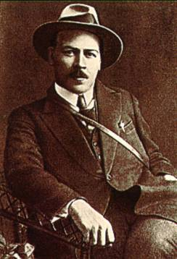
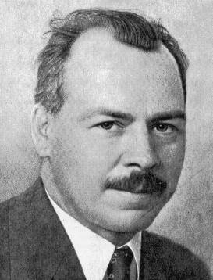
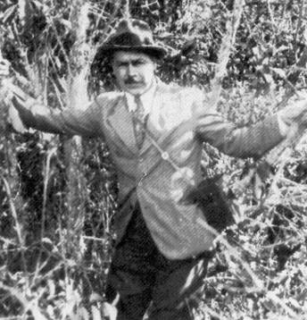
Nicolay Ivanovich Vavilov
1887-1943
The father of plant genetic resources
Centers of Origin of Cultivated Plants
Law of Homologous Series in Variation
Notes:
BEFORE GENEBANKS WERE SET UP AROUND THE WORLD, PLANT BREEDERS WOULD TRAVEL TO DISTANT AND ISOLATED PLACES IN SEARCH OF DIVERSITY IN LANDRACE VARIETIES AND WILD SPECIES – NO INT'L TREATY THEN TO REGULATE ACCESS TO AND EXCHANGE OF GENETIC DIVERSITY.
THEY UNDERSTOOD THE IMPORTANCE OF BROADENING THE GENEPOOL OF THEIR CROPS.
PRE-EMINENT AMONG THEM WAS MY HERO, NI VAVILOV.
AND OF COURSE IT WAS THROUGH THIS EXPLORATION THAT VAVILOV DEVELOPED HIS THEORIES ABOUT THE ORIGINS OF CULTIVATED PLANTS.

Slide 5
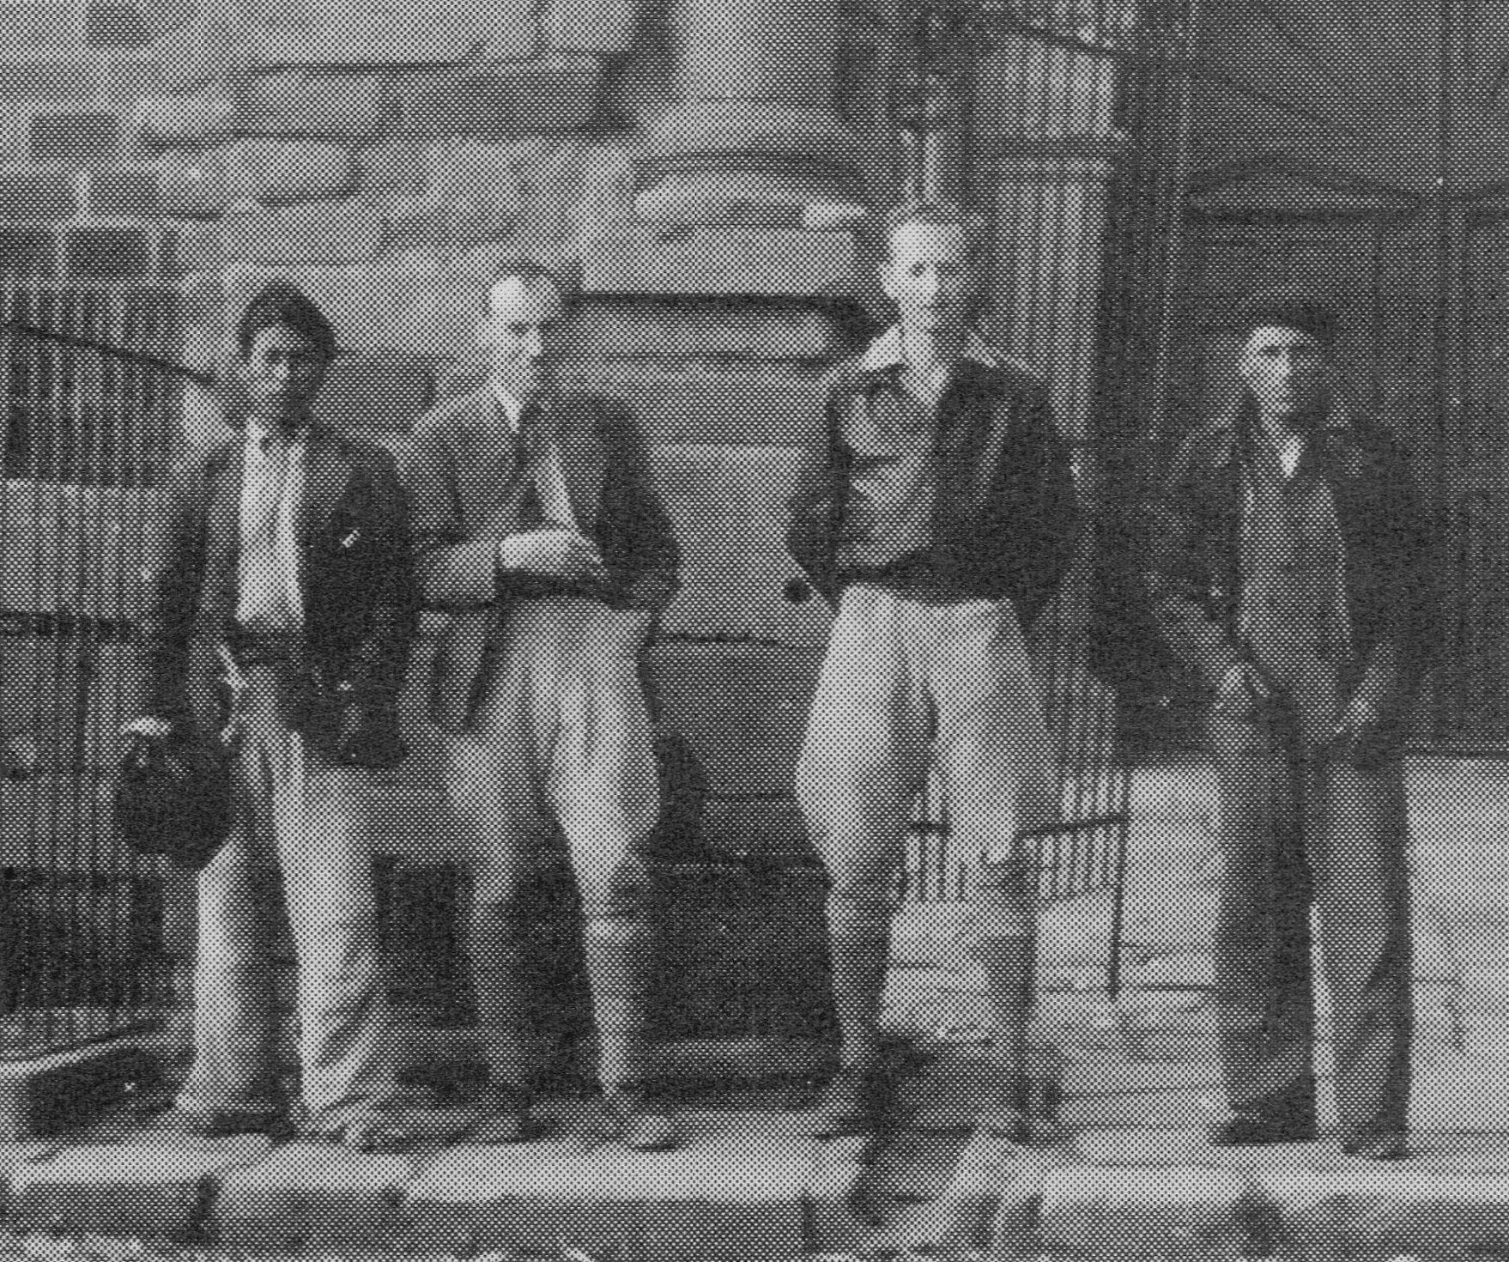
Edwards Balls and Jack Hawkes, March 1939, near Lake Titicaca in Bolivia
during the British Empire Potato Collecting Expedition to South America
1938-1939
From: Hawkes, JG, 2004. Hunting the wild potato in the South American Andes.
Notes:
AND TO MAINTAIN A BIRMINGHAM PERSPECTIVE, HERE WE HAVE A VERY YOUNG JACK HAWKES WHO JOINED THE BRITISH EMPIRE POTATO COLLECTING EXPEDITION TO SOUTH AMERICA IN 1938-39.
THE OBJECTIVE WAS TO INCREASE THE GENE POOL AVAILABLE OF WILD POTATOES TO PLANT BREEDERS IN THE UK.
IN PREPARATION FOR THE EXPEDITION, HAWKES TRAVELLED TO THE SOVIET UNION TO CONSULT WITH SM BUKASOV AND OTHER POTATO EXPERTS.
AND HE MET VAVILOV – MENTION NIEDERHAUSER.
GERMPLASM BECAME BASIS OF THE COMMONWEALTH POTATO COLLECTION – OF MORE LATER.

Slide 6
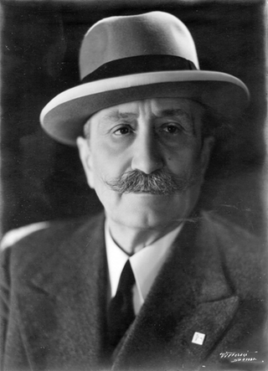
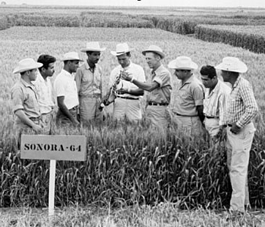
Nazareno Strampelli
(b. 29 May 1866)
‘forerunner of the green revolution’
Source: www.eatthispodcast.com
Norman Borlaug, ‘father of the green revolution’, working with wheat trainees at CIMMYT’s field station at Obregon, north-western Mexico.
Source: CIMMYT Archives
Notes:
NOW WE’VE ALL HEARD OF THE SO-CALLED GREEN REVOLUTION, AND THE SIGNATURE ROLE THAT NORMAN BORLAUG PLAYED IN BREEDING SHORT-STRAWED AND HIGH-YIELDING WHEAT VARIETIES THAT SAVED THE LIVES OF HUNDREDS OF MILLIONS OF PEOPLE WORLDWIDE.
IT’S WORTH POINTING OUT, HOWEVER, THAT AN OBSCURE ITALIAN WHEAT BREEDER, NAZARENO STRAMPELLI, WHOSE 150TH ANNIVERSARY IT WAS JUST A FEW DAYS AGO, WAS DOING WHAT BORLAUG DID BUT 40 YEARS BEFORE, TO INCREASE THE PRODUCTIVITY OF ITALIAN AGRICULTURE.

Slide 7
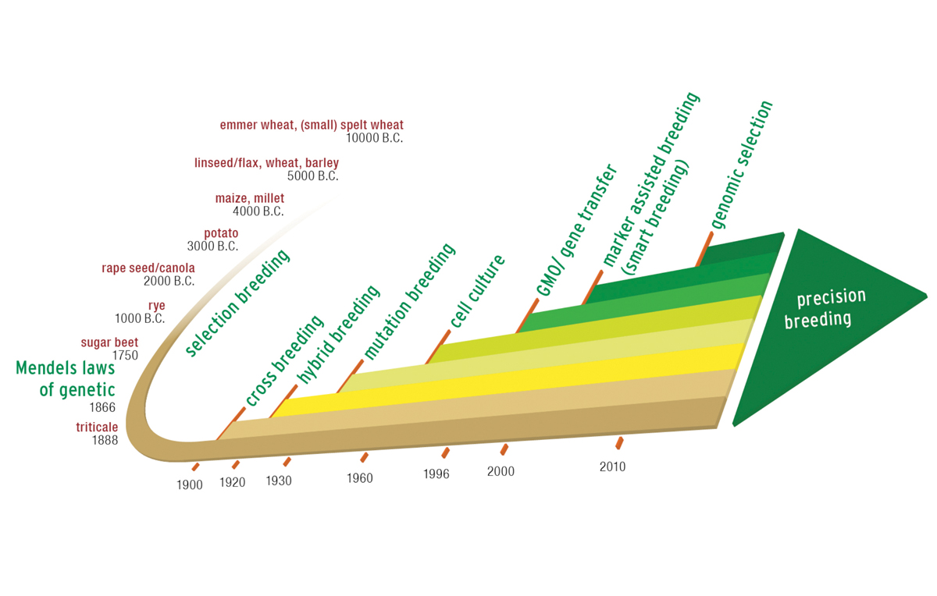
Milestones in plant breeding
Exploration for breeding
Genebank movement begins
From: Petra Jorasch, 2016. europeanseed Vol. 3 Issue 2. 3 May 2016.
http://european-seed.com/much-plant-breeding-innovation-politically-intended/)
Notes:
NOW LET’S LOOK AT VARIOUS MILESTONES IN PLANT BREEDING REPRESENTED IN THIS FIGURE THAT I CAME ACROSS JUST A FEW DAYS AGO.
PRIOR TO THE RELEASE OF THE HIGH YIELDING GREEN REVOLUTION VARIETIES IN THE 1960S, THE IMPACT OF PLANT BREEDING ON AGROBIODIVERSITY HAD BEEN MINIMAL.
BUT IN SOME PARTS OF THE WORLD, CHANGES WERE OBSERVED. GERMPLASM WAS BEING LOST.
DURING THE 1960S, FAO SET UP AN EXPERT PANEL, SPEARHEADED BY SIR OTTO FRANKEL AND ERNA BENNETT TO EVALUATE WHAT SHOULD BE DONE TO ADDRESS THIS LOSS OF DIVERSITY.

Slide 8
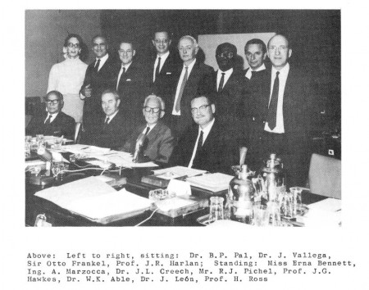
The genetic resources - genebank
pioneers in the 1960s
Notes:
JACK HAWKES WAS A MEMBER OF THAT PANEL SHOWN HERE. I’VE HAD THE PRIVILEGE OF MEETING AND WORKING WITH SEVERAL MEMBERS OF THAT GROUP OF EXPERTS.
AND AMONG THEIR RECOMMENDATIONS WAS A CONCERTED EFFORT TO COLLECT GERMPLASM AND STORE IT IN AN INTERNATIONAL NETWORK OF GENEBANKS THAT HAD YET TO BE SET UP.

Slide 9
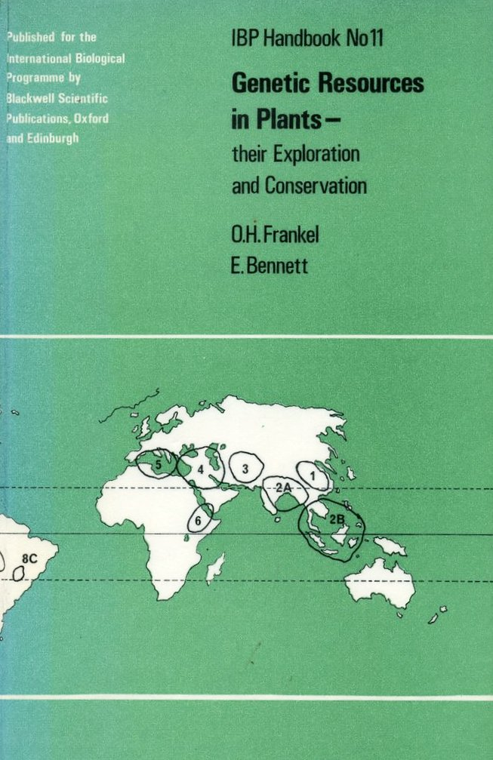
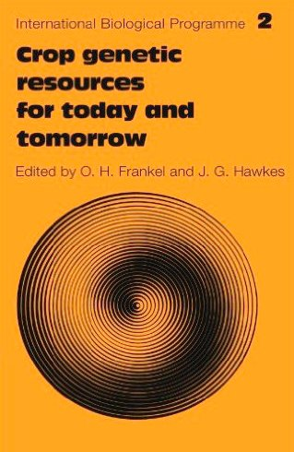
1970
1975
Notes:
THESE WERE TWO FLAGSHIP PUBLICATIONS IN 1970 AND 1975.
STILL GOOD TODAY AND WORTH A READ, ALTHOUGH SOME APPROACHES HAVE BEEN SUPERSEDED.
SET THE TRAJECTORY FOR THE GENETIC RESOURCES MOVEMENT, AND THE ESTABLISHMENT LATER ON IN THE 70S OF THE INTERNATIONAL BOARD FOR PLANT GENETIC RESOURCES, HEADED BY ANOTHER BIRMINGHAM ASSOCIATE, TREVOR WILLIAMS.
ENVISAGED AN INTERNATIONAL NETWORK OF GENEBANKS, OFTEN TAKING ON A REGIONAL ROLE.
BUT AS MANY OF YOU ARE AWARE, POLITICS GOT IN THE WAY.
NATIONAL SOVEREIGNTY OVER BIODIVERSITY, AND RIGHTLY SO.
CONVENTION ON BIOLOGICAL DIVERSITY IN 1992.

Slide 10
State of the World’s Plant Genetic Resources (FAO 2010)
1750 genebanks hold >7 million samples
    11 international collections of the CGIAR
International Treaty on PGRFA came into force in June 2004
Global Crop Diversity Trust established in 2004
Svalbard Global Seed Vault opened in 2008
Notes:
WHAT IS THE SITUATION TODAY?
THERE ARE MORE THAN 1700 GENEBANKS. WHAT WOULD FRANKEL ET AL. MAKE OF THAT?
PROBLEM IS THAT MANY ARE BARELY MAINTAINED, DO NOT MEET INTERNATIONAL STANDARDS FOR CONSERVATION, ARE NOT SUFFICIENTLY CHARACTERIZED OR EVALUATED, AND HARDLY USED.
GENEBANKS ARE OFTEN SEPARATED FROM THE USER COMMUNITY.
UNLIKE THE INTERNATIONAL GENEBANKS OF THE CGIAR WHERE THERE IS A CONTINUUM FROM CONSERVATION TO USE.
BUT EVEN IN A GENEBANK LIKE IRRI'S, ABOUT ONE THIRD OF THE ACCESSIONS HAVE NEVER BEEN REQUESTED OUTSIDE THE INSTITUTE.
YET MOST ACCESSIONS HAVE BEEN CHARACTERIZED, MANY HAVE BEEN EVALUATED FOR DISEASE AND STRESS TOLERANCE. REASONABLY GOOD PASSPORT DATA – BUT MANY GAPS.

Slide 11
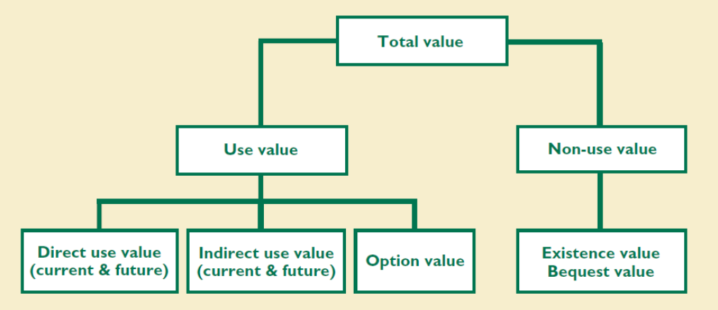
Aesthetic
Cultural
Biological
Monetary
Agronomic
Melinda Smale & Bonwoo Koo, 2003. Biotechnology and Genetic Resources Policies: What is a genebank worth? Briefs 7. IFPRI, IPGRI & SGRP.
Notes:
SMALE AND BONWOO KOO DEVELOPED THIS TAXONOMY OF GENEBANKS VALUES.
WHILE IT’S USEFUL TO HAVE A DICHOTOMY BASED ON USE PER SE, THERE ARE OTHER ASPECTS THAT WE CAN CONSIDER, SUCH AS HERITAGE OR CULTURAL VALUE, AS WELL AS MONETARY AND AGRONOMIC VALUE.
DIRECT VALUE REFERS TO ITS USE IN PLANT BREEDING FOR EXAMPLE
INDIRECT VALUE – CONTRIBUTIONS TO ECOSYSTEM SERVICES, FOR EXAMPLE
OPTION VALUE – A VALUE YET TO BE REALIZED – AND THIS IS CHANGING WITH THE RAPID DEVELOPMENTS IN THE NEW BIOLOGY AND BIG DATA APPROACHES, MORE OF WHICH LATER.
ENDOWMENT VALUE – SOMEONE IS PREPARED TO PAY $500 MILLION TO SET UP AN ENDOWMENT THAT WILL YIELD THE $20 MILLION TO SUPPORT THE INTERNATIONAL COLLECTIONS IN PERPETUITY.

Slide 12
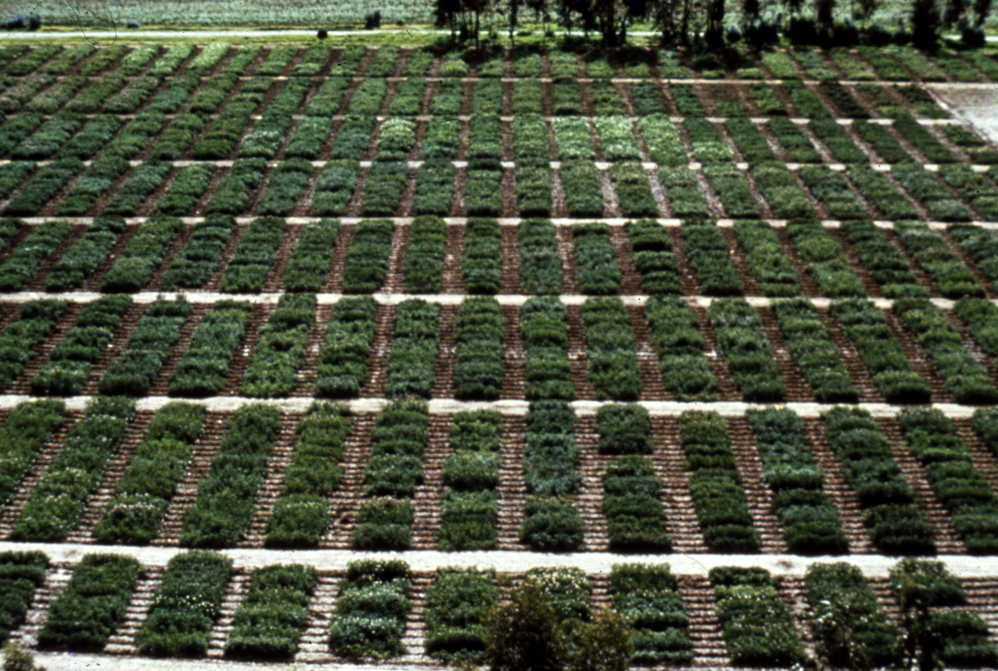
Field multiplication of the potato collection at CIP,
in Huancayo, central Peru, 3100 m
Source: CIP
Notes:
LET’S LOOK AT HOW THE MANAGEMENT OF A COLLECTION OF POTATOES IN PERU HAS EVOLVED OVER THE YEARS, AND HOW VALUE HAS BEEN ADDED TO THE COLLECTION.
CIP WAS FOUNDED IN 1971. FOR SEVERAL YEARS FROM 1973 (WHEN I JOINED AS AN ASSOCIATE TAXONOMIST) THERE WERE POTATO COLLECTING EXPEDITIONS ALL OVER THE ANDES FOCUSING ON PERU AND BOLIVIA. COLLECTIONS WERE SENT TO CIP FORM OTHER COUNTRIES.
THE COLLECTION GREW TO ABOUT 15,000 CLONES, PLANTED OUT EACH YEAR AT HUANCAYO AS SHOWN HERE.
MAJOR MANAGEMENT ISSUE – TUBER-BORNE VIRUSES AND OTHER DISEASES.
COLLECTION REDUCED TO ABOUT 4000 CLONES, AND TRUE SEED COLLECTED FROM INDIVIDUAL SELF FERTILE CLONES, OR BULKED CROSSES FROM THE SELF-INCOMPATIBLE DIPLOIDS. ISSUE OF SEED BORNE VIRUSES.

Slide 13
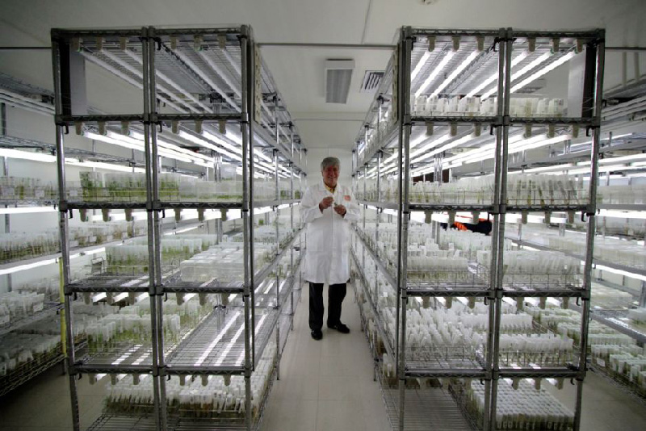
The CIP in vitro potato collection
Source: CIP
Notes:
NOW THE COLLECTION IS MAINTAINED AS AN IN VITRO COLLECTION.
IT IS DISEASE INDEXED – AN ESSENTIAL CONSIDERATION IN TERMS OF ACCESS TO THE GERMPLASM AND ITS EXCHANGE WORLDWIDE.
COSTS ABOUT $3 MILLION PER ANNUM TO MAINTAIN THIS COLLECTION.
ONE WAY OF LOOKING AT VALUE IS WHAT SOMEONE IS WILLING TO PAY FOR ITS CONSERVATION.
IS IT WORTH IT? IS IT NECESSARY TO MAINTAIN THE UNIQUE CLONAL IDENTITY? DNA STORAGE AT SOME STAGE IN THE FUTURE.

Slide 14
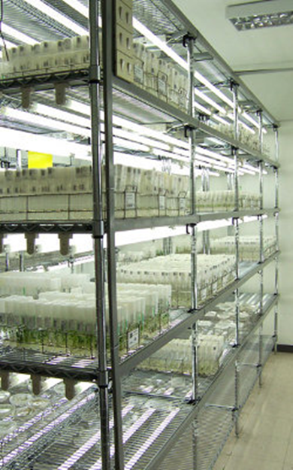
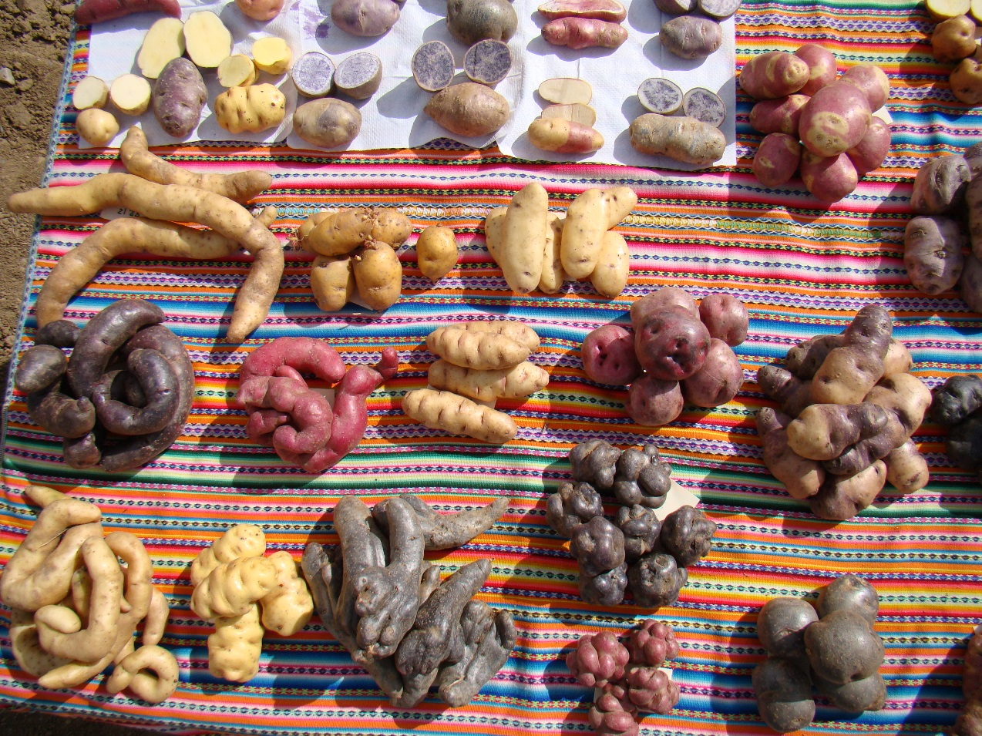
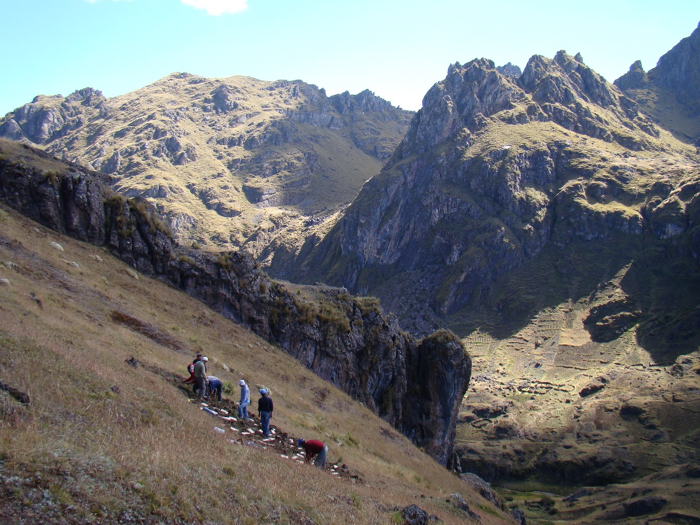
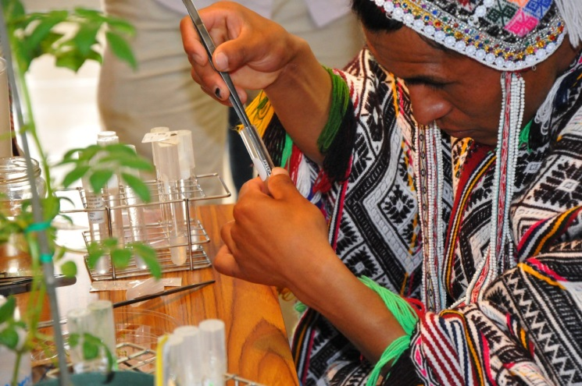
CIP – Parque de Papa
Source: CIP
Notes:
TO POTATO FARMERS IN PERU THE CIP COLLECTION IS AN ESSENTIAL BACKUP RESOURCE.
OF GREAT VALUE, SINCE FARMERS’ GROUPS CAN RECEIVE DISEASE-FREE CLONES OF THE VARIETIES THEY HAVE CHERISHED FOR GENERATIONS.
THIS IS A HERITAGE AND CULTURAL VALUE OF THE CIP POTATO COLLECTION.
THE PARQUE DE PAPA IS A PARTNERSHIP BETWEEN CIP AND A GROUP OF COMMUNITIES IN THE SOUTH OF PERU NEAR CUZCO.

Slide 15
Hybrids with GP-1 anomalous,
lethal, or completely sterile
GP-3
All species that cross with GP-1, with some F₁ fertility
GP-1
Subspecies A
cultivated races
GENEPOOL
CONCEPT
Harlan & de Wet 1971
GP-2
BIOLOGICAL SPECIES
GP-2
Subspecies B
spontaneous races
GP-1
Gene transfer possible but may be difficult
Gene transfer not possible or
requiring radical techniques
GP-3
Notes:
THE BIOLOGICAL VALUE REFERS TO THE EASE WITH WHICH GERMPLASM MAY BE USED IN PLANT BREEDING.
THE BIOLOGICAL VALUE OF GERMPLASM ACCESSIONS VARIES.
NOT ALL CAN BE CROSSED EASILY WITH CROP SPECIES – PARTICULAR ISSUE FOR CROP WILD RELATIVES.
I’VE ALWAYS FOUND THE HARLAN AND DE WET GENEPOOL CONCEPT A USEFUL TOOL CLASSIFY GERMPLASM IN A GENEBANK. BUT KNOWING WHAT THE BIOLOGICAL VALUE OF GERMPLASM IS DOES DEPEND ON WHAT PRE-BREEDING ACTIVITIES ARE BEING PURSUED AND WHERE. PREFERABLY LINKED TO THE GENEBANK DIRECTLY.

Slide 16
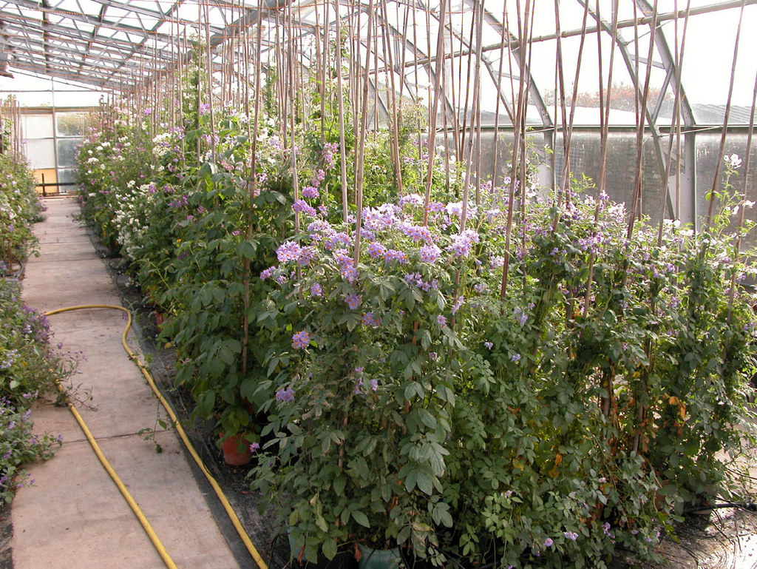

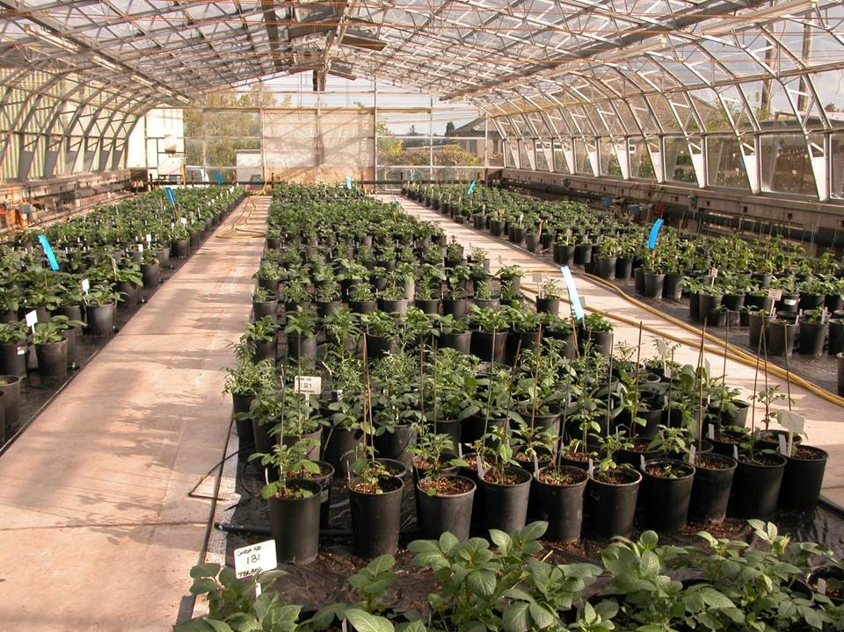
Commonwealth Potato
Collection
The collection comprises around 1500 accessions of about 80 wild and cultivated potato species. Each accession traces back to a handful of berries or tubers from potato plants in South or Central America, gathered from the wild or obtained from a grower at a market.
Notes:
LET ME NOW PROVIDE SOME EXAMPLES FROM POTATO AND RICE OF AGRONOMIC VALUE – THAT FOR ME IS THE MOST IMPORTANT VALUE.
THE COMMONWEALTH POTATO COLLECTION IN SCOTLAND IS A SIGNATURE EXAMPLE OF HOW A GERMPLASM COLLECTION HAS BEEN BUILT TO SUPPORT THE POTATO BREEDING INDUSTRY. HAS ITS BASIS AS I SAID EARLIER IN THE 1938-39 EXPEDITION TO SOUTH AMERICA.
FURTHER INPUTS FROM BIRMINGHAM WHEN THE HAWKES COLLECTION WAS DONATED TO THE CPC.
BUT ADDED VALUE BY DISEASE INDEXING SO IT CAN BE USED IN THE UK, FOR VIRUS DISEASES IN PARTICULAR.
AND THE MATERIAL IS OFFERED FOR EXCHANGE THAT IS WELL DOCUMENTED, HEALTHY, AND LINKED TO A DYNAMIC RESEARCH PROGRAM TAKING ADVANTAGE OF THE NEW BIOLOGY.
SOME BIOLOGICAL CONSTRAINTS – ENDOSPERM BALANCE NUMBERS (EBN).

Slide 17
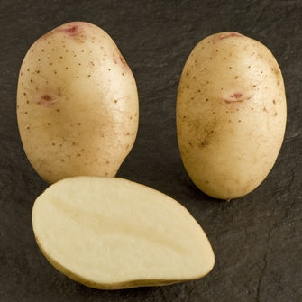
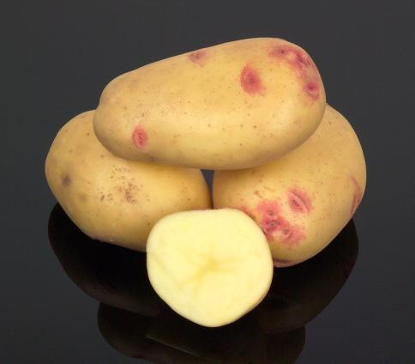
Lady Balfour (2001) is now the number one organic variety in Britain. It has partial resistance to both the golden and the white potato cyst nematodes derived from the diploid South American species Solanum vernei (CPC2487 and 2488). The CPC accessions were treated with colchicine in 1957 to produce tetraploid S. vernei for crossing with cultivars of the European potato. Lady Balfour is six generations removed from S. vernei.
Vales Sovereign (2003) is the latest in a line of cultivars dating back to Pentland Javelin (1968) with the H1 gene from Andigena potato CPC1673. This continues to provide resistance to the only pathotype of the golden potato cyst nematode present in Britain.
Sources: AHDB Potato Variety Database
James Hutton Institute website
Notes:
HERE ARE JUST TWO EXAMPLES OF HOW GENES FROM CPC ACCESSIONS HAVE BEEN TRANSFERRED INTO NEW POTATO VARIETIES.
NOTE HOWEVER JUST HOW LONG IT TOOK FOR THESE VARIETIES TO BE DEVELOPED.
OF PARTICULAR NOTE IS THE RESISTANCE TO POTATO CYST NEMATODE.

Slide 18
The CPC has provided crucial germplasm to the research and breeding community, and just one gene, H1, from Solanum tuberosum Group Andigena CPC1673 has given resistance to the PCN species Globodera rostochiensis in more than half of the current UK National Listed potato cultivars. The economic and environmental savings brought about by this one gene are enormous, and current research is looking to consolidate this benefit by bringing in new sources of resistance from the CPC to the other PCN species, G. pallida, now overtaking G. rostochiensis as the deployment of H1 suppresses the latter.
Source: James Hutton Institute
Notes:
THE ENVIRONMENTAL AND ECONOMIC SAVINGS OF JUST ONE GENE.

Slide 19
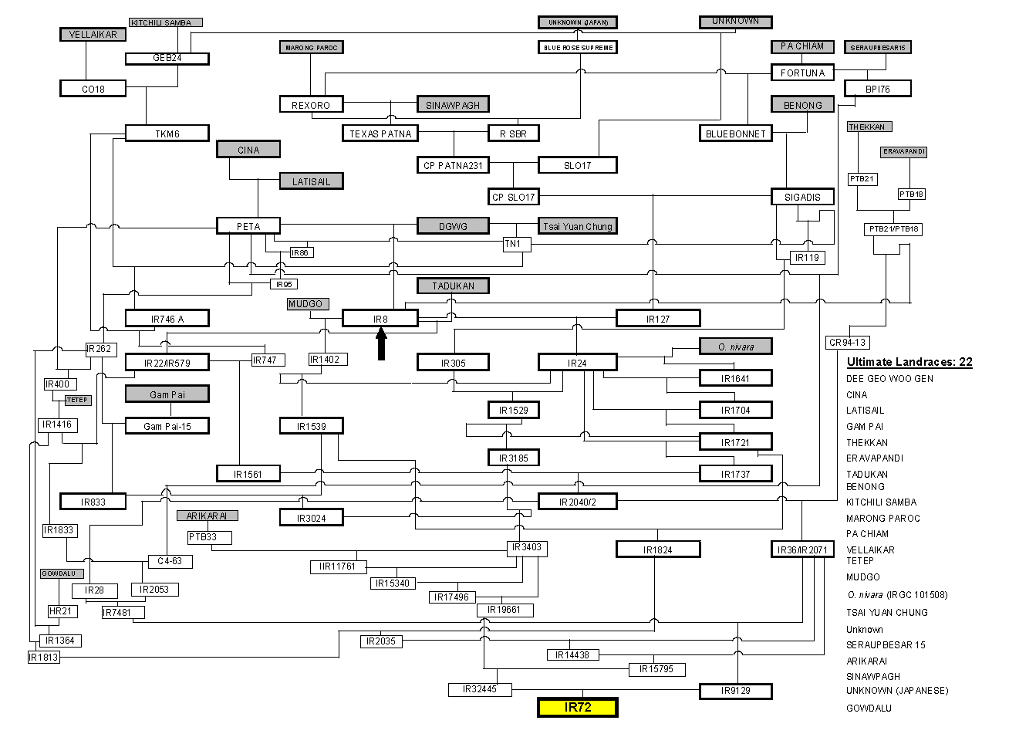
The pedigree of rice variety IR72
Source: IRRI
Notes:
NOW LET’S TURN TO RICE, THE WORLD’S MOST IMPORTANT CROP FEEDING HALF THE WORLD’S POPULATION ON A DAILY BASIS, AND IN MANY COUNTRIES IN SOUTH AND SOUTH-EAST ASIA, SEVERAL TIMES A DAY. HAVING ACCESS TO A RELIABLE SOURCE OF RICE IS PARAMOUNT.
IN THE DEVELOPMENT OF A VARIETY SUCH AS IR72, ONCE THE WORLD’S MOST WIDELY CULTIVATED CEREAL VARIETY, A NUMBER OF LANDRACES AND A WILD SPECIES HAVE CONTRIBUTED VALUABLE TRAITS.
THE CHINESE VARIETY DEE GEE WOO GEN CONTRIBUTED THE DWARF GENE. ORYZA NIVARA GAVE RESISTANCE TO GRASSY STUNT VIRUS. THIS WAS THE KEY TRAIT THAT ENABLED IR72 TO BECOME SUCH A POPULAR VARIETY.

Slide 20
Milestones in plant breeding
New Biology / Big Data
From: Petra Jorasch, 2016. europeanseed Vol. 3 Issue 2. 3 May 2016.
http://european-seed.com/much-plant-breeding-innovation-politically-intended/)
Notes:
SO LET’S COME UP TO THE PRESENT WITH THE APPLICATION OF MARKER-ASSISTED SELECTION, THE SEQUENCING OF CROP GENOMES, AND THE LIKE. I JUST READ TWO DAYS AGO THAT THE GENOME OF A PEANUT ANCESTOR HAS BEEN SEQUENCED.
THIS NEW BIOLOGY AND THE BIG DATA THAT IS THE CONSEQUENCE IS PROVIDING OPPORTUNITIES TO EXPLORE THE DIVERSITY OF GENEBANK ACCESSIONS – CULTIVATED AND WILD – THAT WERE UNIMAGINABLE JUST A FEW YEARS AGO. PERHAPS THERE HAS NEVER BEEN A MORE EXCITING TIME TO BE INVOLVED IN THE FIELD OF PLANT GENETIC RESOURCES CONSERVATION AND USE.

Slide 21
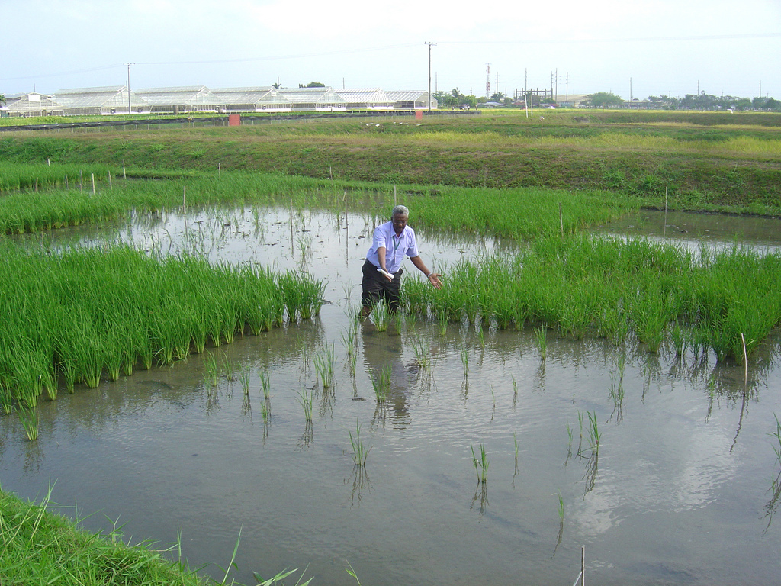
Evaluating rice varieties with and without the SUB1 gene from
Indian variety FR13A (IRGC6144) that confers
tolerance to submergence for up to three weeks.
Source: IRRI
Notes:
MORE THAN A COUPLE OF DECADES AGO A SEARCH BEGAN TO IDENTIFY TOLERANCE TO SUBMERGENCE DAMAGE. RICE WILL DIE IF SUBMERGED FOR MORE THAN ABOUT THREE WEEKS OR SO.
THE SUB1A GENE FROM INDIAN VARIETY FR13A WAS CHARACTERIZED AND USING MARKER AIDED SELECTION TRANSFERRED TO A NUMBER OF WIDELY-CULTIVATED ASIAN VARIETIES LIKE SWARNA.
HERE MY FORMER COLLEAGUE, IRRI CROP PHYSIOLOGIST ABDEL ISMAIL POINTS TO A VARIETY WITH THE SUB1 GENE THAT IS GROWING PRODUCTIVELY AFTER A PERIOD OF SUBMERGENCE. THE SAME VARIETY WITHOUT THE GENE IS GROWING ALONGSIDE.

Slide 22
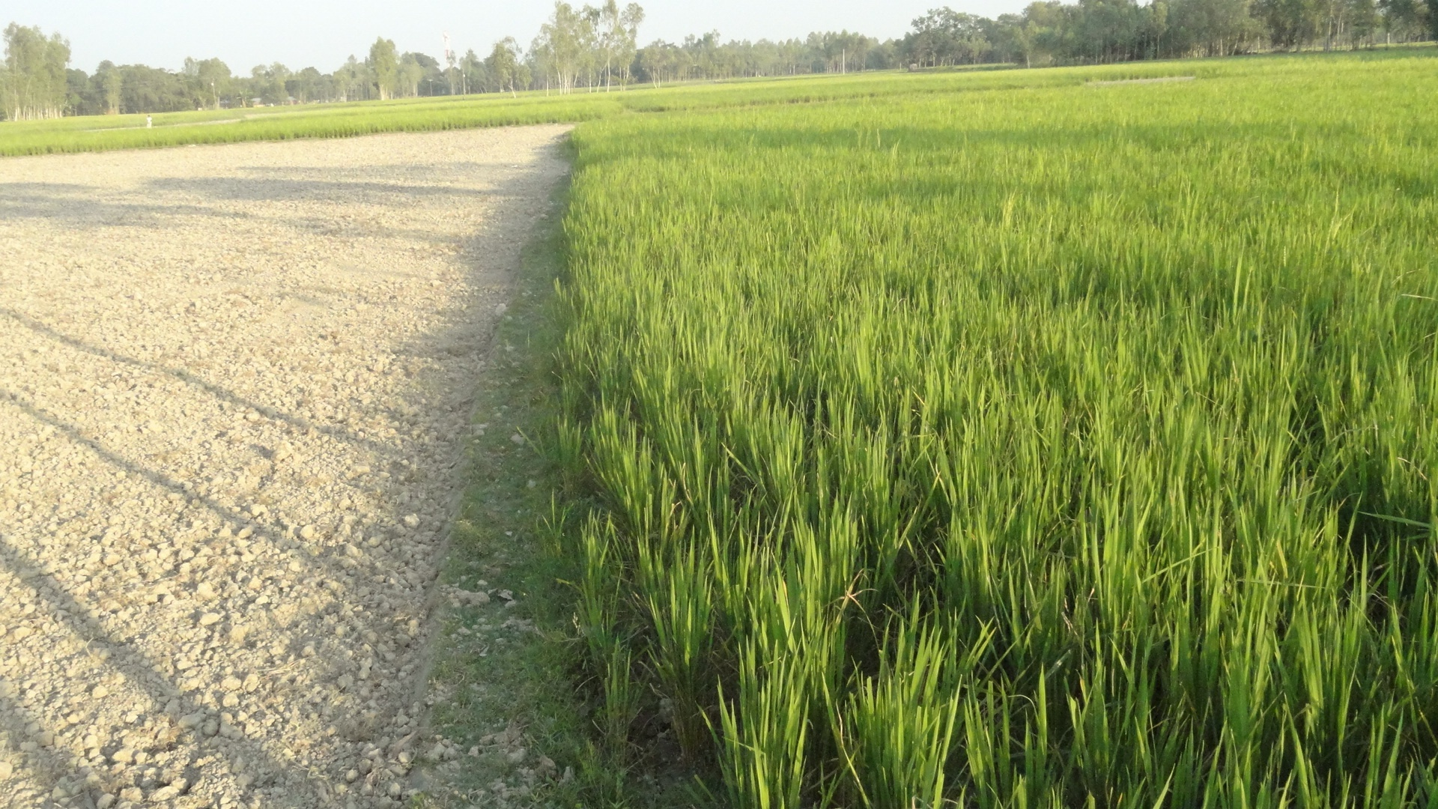
Field performance of Sub1 Varieties in Bangladesh (Aman 2015)
Farmer: Jasoda Bala
Village: West Barubari; Union: Barubari; Upazila: Nageswari; District: Kurigram
Binadhan-11
Swarna
Submergence: 22-23 days
BRRI Dhan 51
Submergence: 18 days
Yield 5.04 t/ha
Source: IRRI
Notes:
AND HERE IS THE PROOF OF THAT RESEARCH AND USE OF GENEBANK ACCESSIONS.
SUBMERGENCE TOLERANT VARIETIES ARE NOW CONTRIBUTING TO PRODUCTIVE AGRICULTURE IN EASTERN INDIA AND BANGLADESH.
ADOPTED BY ABOUT 5 MILLION FARMERS, AND ABOUT 20 MILLION TONNES ARE NOW PRODUCED WHERE NONE OR LITTLE COULD BE GROWN BECAUSE OF THE THREATS OF SUBMERGENCE.

Slide 23
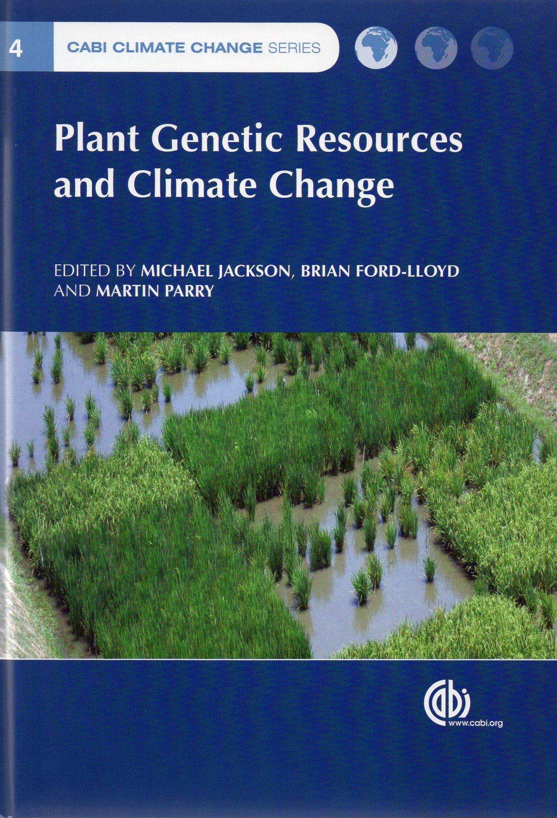
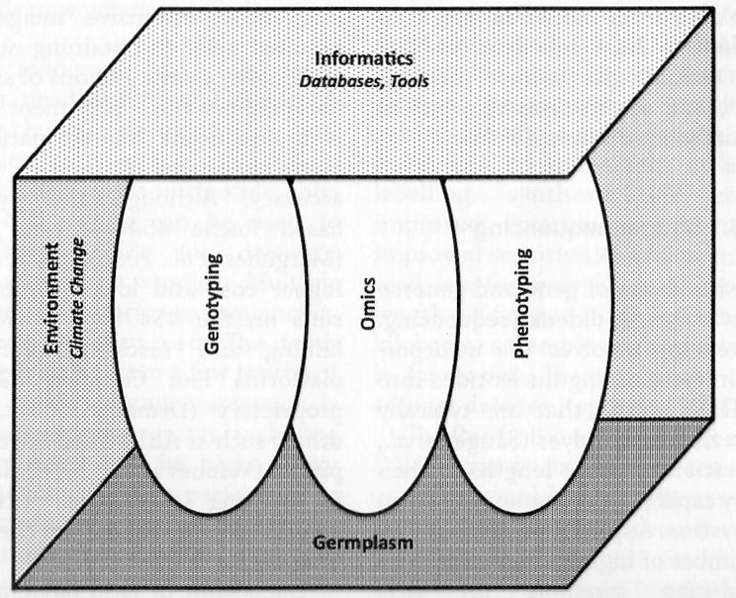
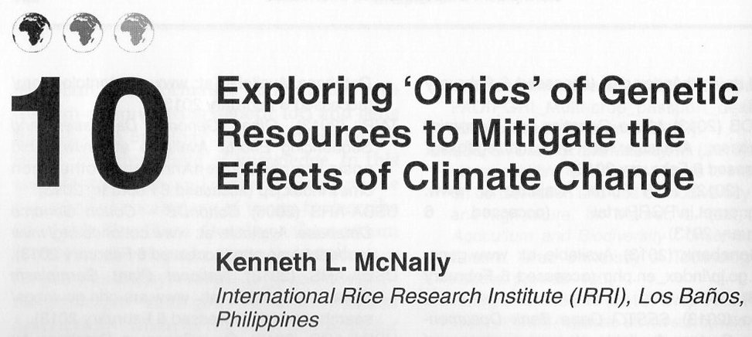
The 3000 rice genomes project
GigaScience 2014 3:7
DOI: 10.1186/2047-217X-3-7
Notes:
GENOMICS IS OPENING UP THE GENEBANK COLLECTIONS
IMPORTANT TO ESTABLISH THE RELATIONSHIP BETWEEN GENOTYPE AND PHENOTYPE.
BIG DATA.
THIS IS WHERE OPTION VALUE WILL BE TRANSLATED INTO DIRECT USE VALUE.
THE FUTURE IS BRIGHT!

