Slide 1
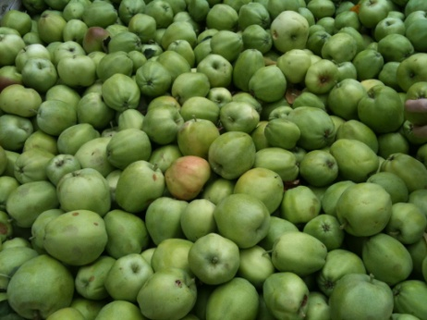
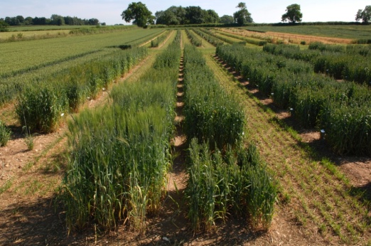
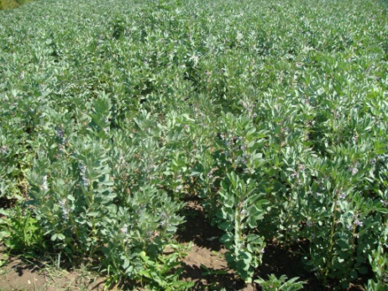
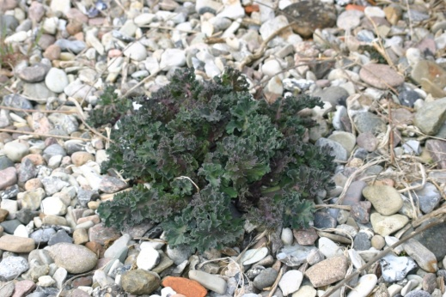
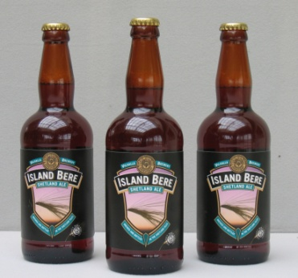
CUPGR: a context
Plant Genetic Resources:
Our challenges, our food, our future
2nd June 2016
N. Maxted

Slide 2
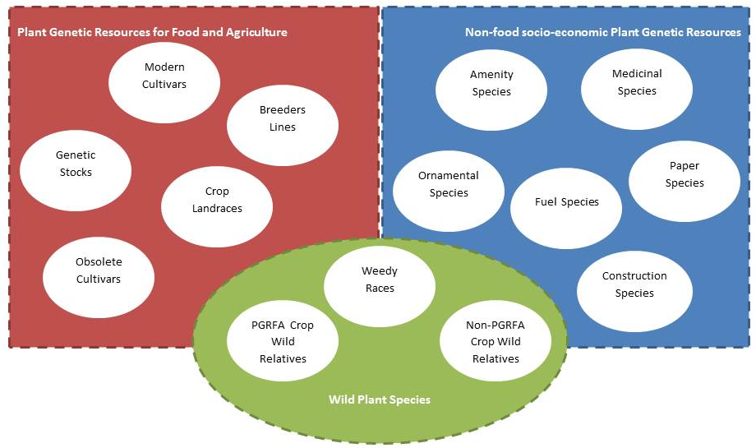
  Scope and ambition
Scope: LR, CWR, MP & WHS
Goal is efficient and effective PGR conservation AND USE

Slide 3
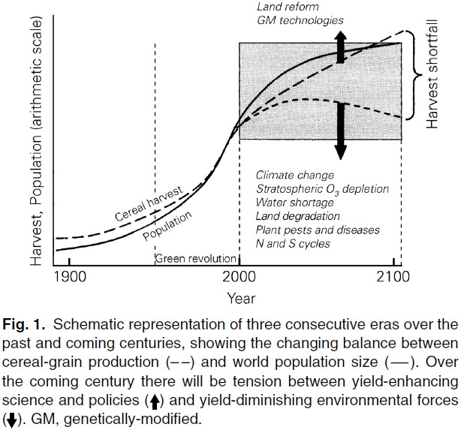
Challenge of the world’s food security
Earth Policy Institute (2013)

Slide 4
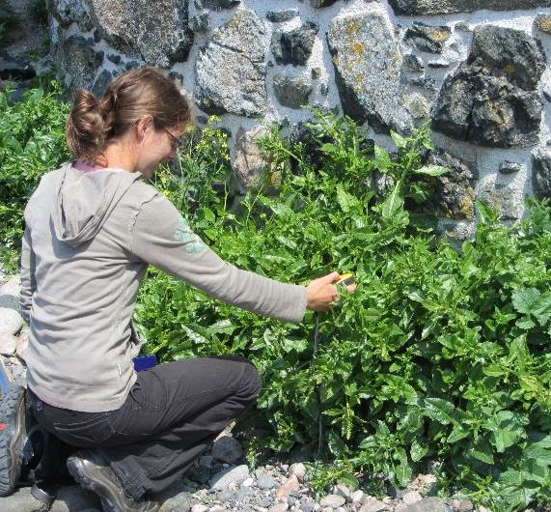
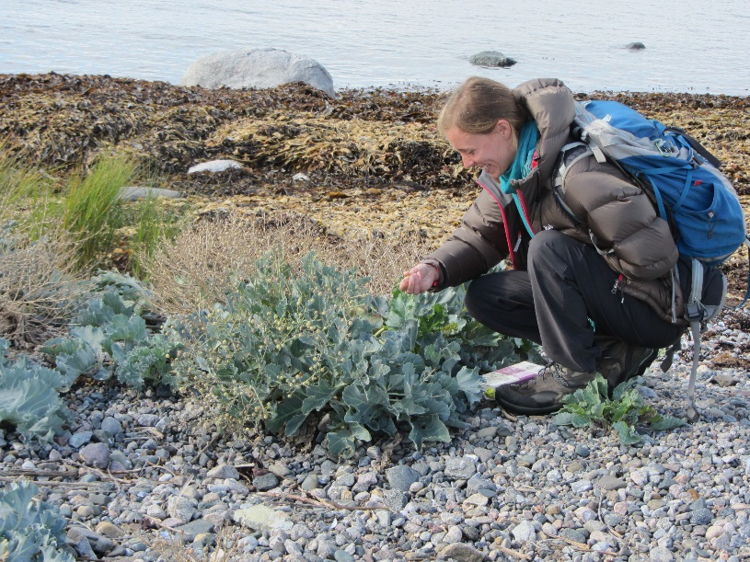
What is a crop wild relative (CWR)?
A crop wild relative is a wild plant taxon that has an indirect use derived from its relatively close genetic relationship to a crop;
Crambe
maritima
Beta
vulgaris
var.
maritima
this relationship is defined in terms of the CWR belonging to gene pools 1 or 2, or taxon groups 1 to 4 of the crop

Slide 5
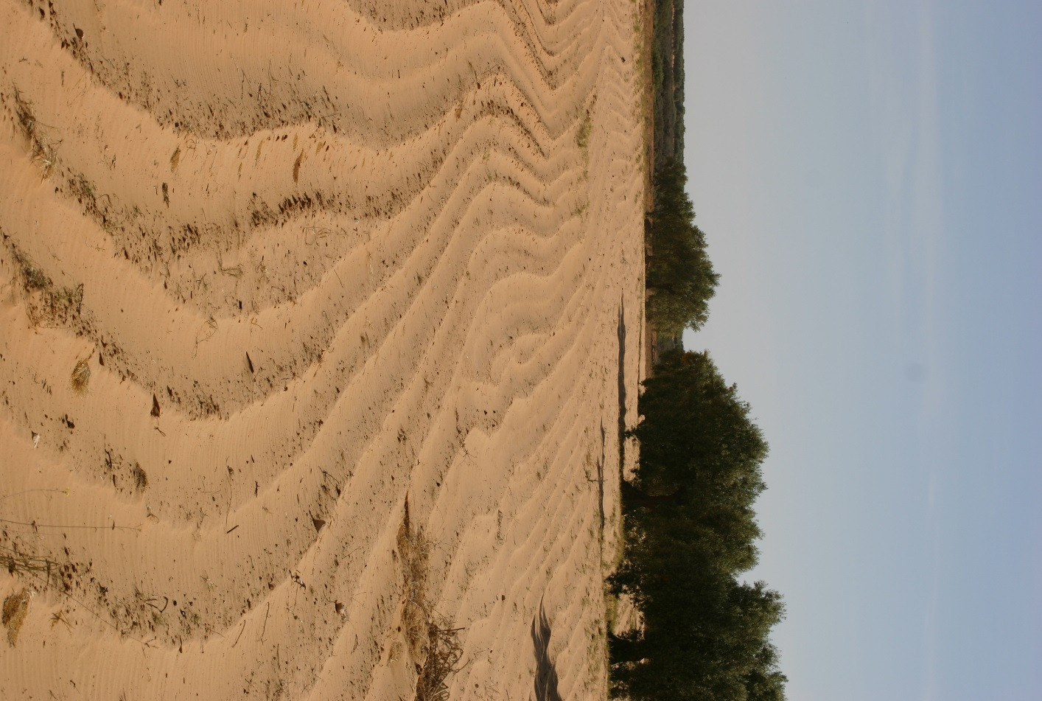
Climate change as a threat to Food Security and CWR
Threat
- The International Panel on Climate Change (IPCC) estimates that by 2100, wheat yields in Europe will decrease by up to 40% unless climate change mitigation is undertaken
+ CWR are important for mitigating the impact of climate change because their genetic diversity provides greater resistance to drought, flooding, salt or heat
  Evidence includes:
      Jarvis et al. (2008): generated climatic envelopes for Arachis, Solanum and Vigna and compared current distribution with 2055 range:
            For three crop genera, 16–22% of CWR taxa will become extinct
            Most species will lose 50% of their range and range highly fragmented
            Effects vary depending on crop gene pools; the worst case is peanut, (Arachis spp.) with 24–31 taxa (out of 50) becoming extinct and range decreasing by 85–94% for extant spp.
          Ureta et al. (2012) 16-39% range reduction for maize CWR by 2050
Tunisia not Europe: YET!!!!

Slide 6
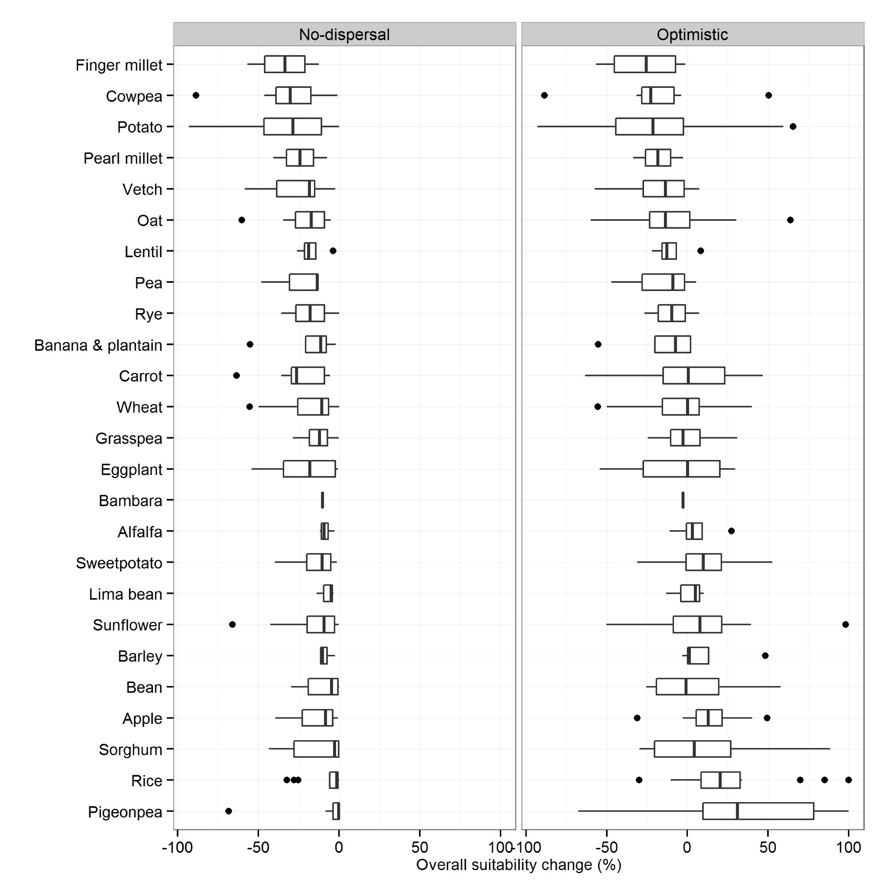
Setting the scene
Relatedness category | No. of CWR | No-dispersal scenario |  | Optimistic dispersal scenario
 |  | No. of CWR taxa losing > 50% range | Average % area loss (SD) | No. of taxa losing > 50% | Average % area loss (SD)
Primary gene pool | 94 | 3 | -18.35 (15.25) | 2 | 16.75 (144.47)
Secondary gene pool | 241 | 23 | -23.53 (23.94) | 22 | -3.99 (50.52)
Tertiary gene pool | 91 | 1 | -15.53 (15.95) | 1 | 7.75 (33.44)
CC Modelling for 2050
Castenada et al. In Prep.

Slide 7
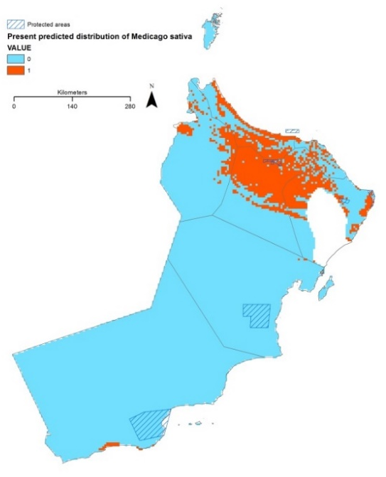
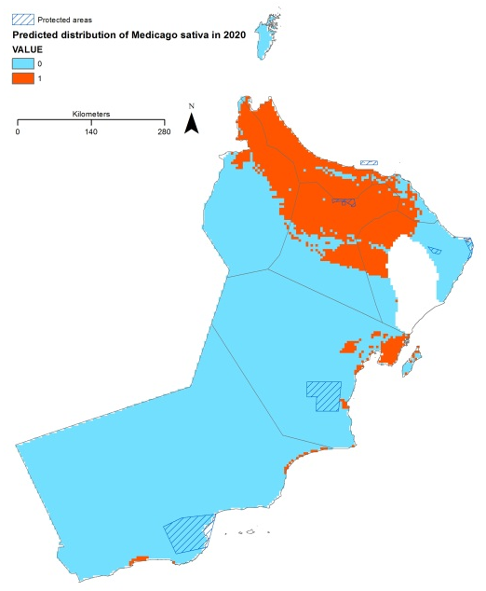
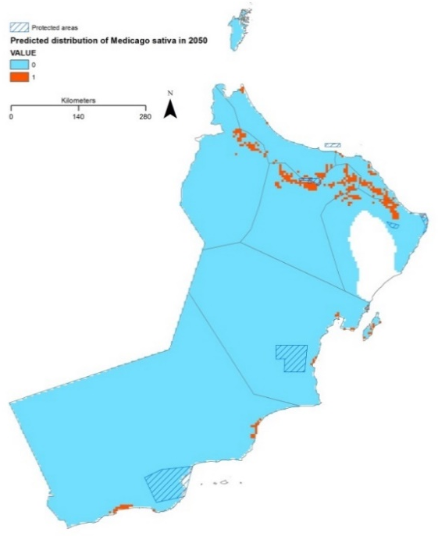
Climate change has changed the game
Climate change reduce agricultural production by 2% per decade (IPCC, 2014), but demand increases 14% FAO (2011)
2015 @ 12%/Oman 2020 @ 17.4%/Oman 2050 @ 2.3% of Oman
Food insecurity & human malnourishment is a real problem in our lifetimes
CWR are important for mitigating the impact of climate change because their genetic diversity provides greater resistance to drought, flooding, salt or heat
CWR may hold one key to human survival
  Wide genetic diversity of adaptive traits
  Tried, proven but still largely unapplied
  Technological advances in application

Slide 8
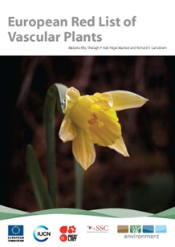
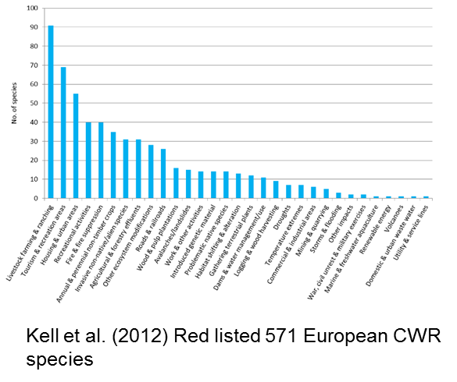
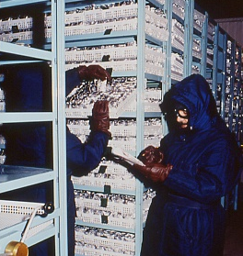
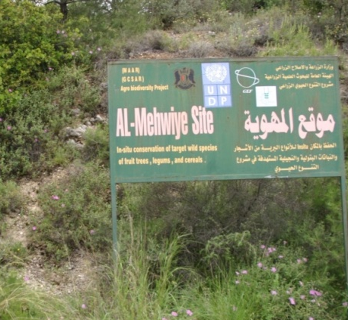
Why crop wild relatives?
CWR are threatened and poorly conserved
Red List assessments of 572 native European CWR in 25 Annex I priority crop gene pools
  16% of the species assessed are threatened or Near Threatened and 4% are Critically Endangered
Yet analysis of PGR ex situ collections found:
  CWR taxa represent only 10% of total germplasm accessions
  Castañeda et al. (2016) reviewed ex situ holdings found
    ⅓ unconserved
    ⅓ poorly conserved (<10 accessions)
Many CWR are found in existing protected areas, but they are not being actively monitored and managed
Only a handful of CWR active genetic reserves have been established: Triticum CWR in Israel; Zea perennis in Mexico; Solanum CWR in Peru; wild Coffee CWR in Ethiopia; and Beta patula in Madeira

Slide 9
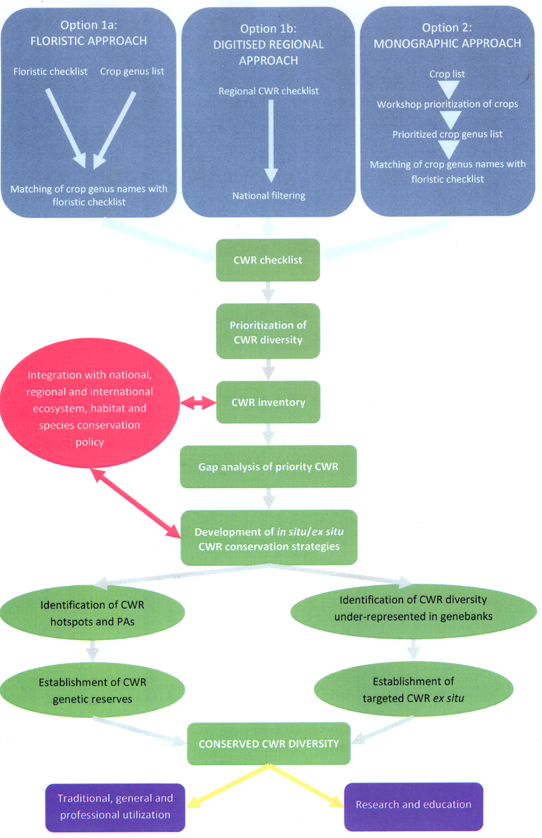
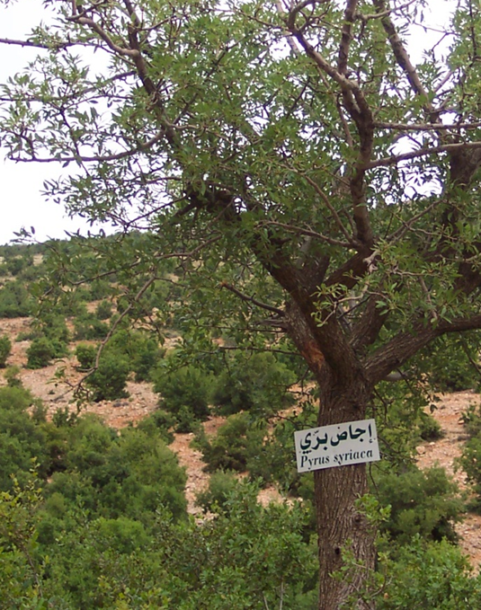
National CWR Strategy
Progress in Europe: Albania, Azerbaijan, Belarus, Bulgaria, Cyprus, Czech Rep., Finland, Greece, Ireland, Italy, Portugal, Norway, Spain, Sweden and United Kingdom
Progress in outside Europe: Armenia, Bolivia, Madagascar, Sri Lanka and Uzbekistan, Middle East, Mexico, Peru, India

Slide 10
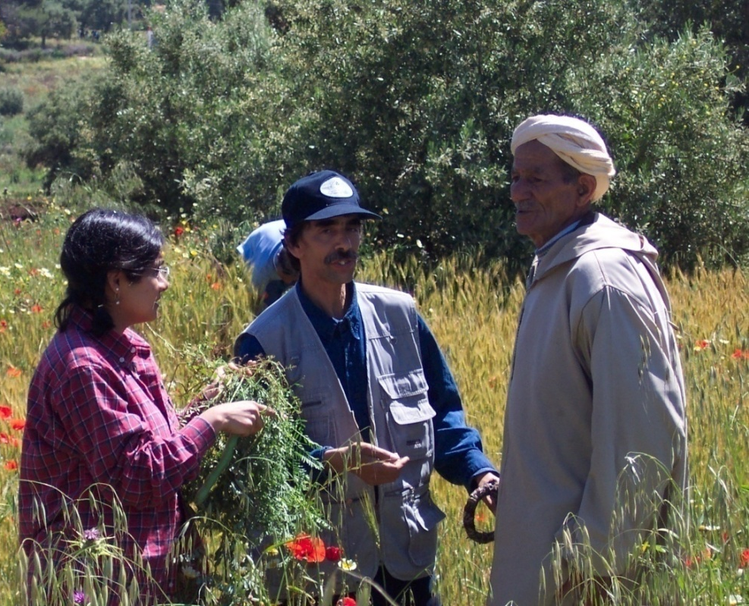
Working definition of landraces
Characteristics:
  A landrace is a dynamic population of a cultivated plant species that has
  historical origin,
  distinct identity and
  lacks formal crop improvement,
  genetically diverse,
  locally adapted and associated with
  traditional farming systems
  cultural associations
Camacho Villa et al. (2005)

Slide 11
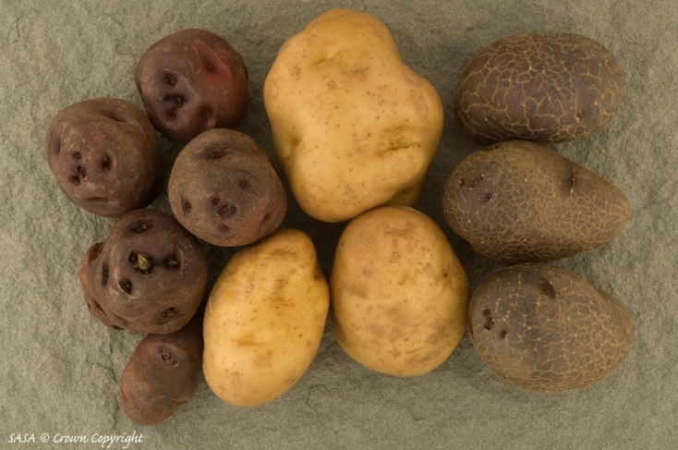
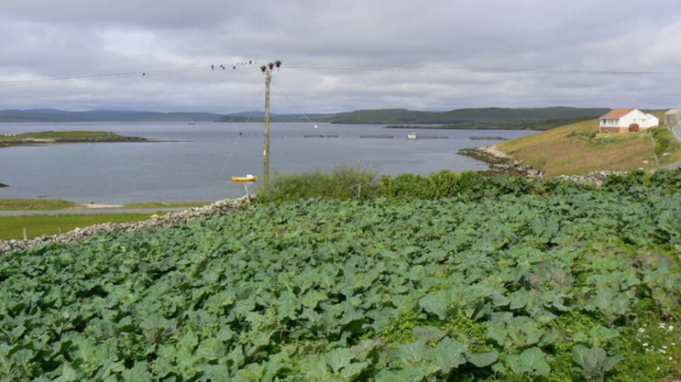
Indigenous PGR: Landraces
Recent inventories indicate that extensive LR diversity in UK cereals, forage crops, and fruit and vegetables (Scholten et al., 2003; Kell et al., 2009).
Highly threatened by
  No idea how many LR exist
  Landrace maintainers are old (> 65)
  Farmers grow for economic return
  Seed companies promoting modern cultivar replacement of LR
  No agency has direct responsibility
  No comprehensive inventory of LR

Slide 12
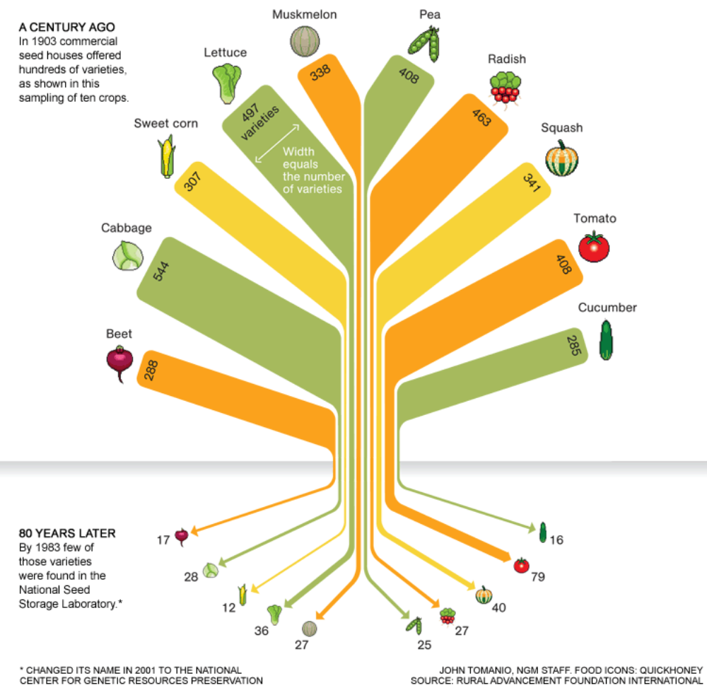
Threat Facing LRs
1903
1983
Rural Advancement Foundation International (1983) via National Geographic (2011)

