Slide 1
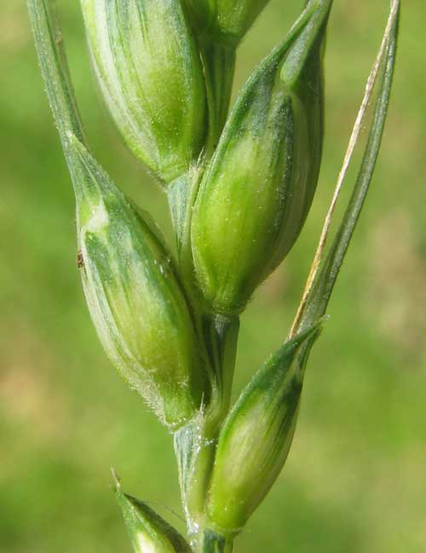
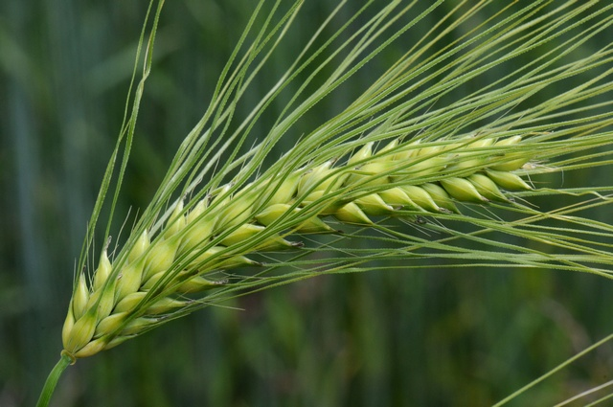



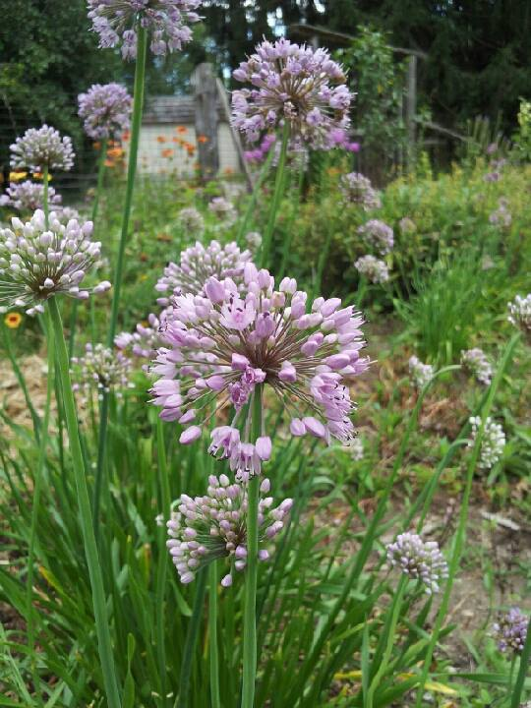
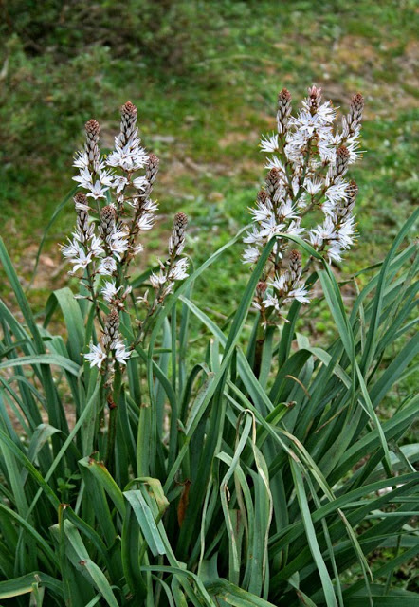
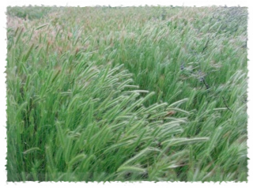
Developing Strategies for Genetic conservation of Crop Wild Relatives in North Africa
Sami Lala., Ahmed Amri and Nigel Maxted

Slide 2
Outlines
CWR Checklist
CWR Priority for conservation
Eco-geographic survey and gap analysis
Diversity hotspots
Assessment of the impact of climate change

Slide 3
Main aims
Create the first regional crop wild relative (CWR) conservation strategy for North Africa.
Establishing CWR database to aid their conservation in North Africa
Identification of genetic reserves location, ex situ backup and recommendations to improve and ensure population management and sustainable utilization of the taxa at each genetic reserve site.
Eco-geographic survey and genetic diversity of Hordeum spontenum in North Africa.
Climate smart conservation and use of North African CWR diversity

Slide 4
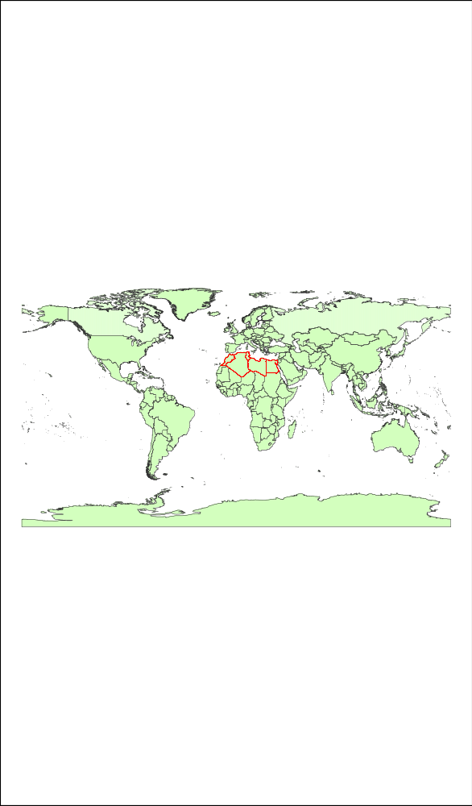
Study area
North Africa (Algeria, Egypt, Libya, Morocco and Tunisia)

Slide 5

Introduction
Objectives
Materials and Methods
Results
Conclusion
1 CWR Checklist
a. CWR flora methodology
Euro-Med CWR Catalogue (PGR Forum) (Kell et al., 2005; Kell et al., 2008)
North Africa Regional CWR Checklist
The economic value of crop taxon
The degree of relatedness
Prioritization
Threat assessment using (IUCN) red list criteria
North Africa CWR Priority list
Creating a regional CWR Checklist and prioritization

Slide 6
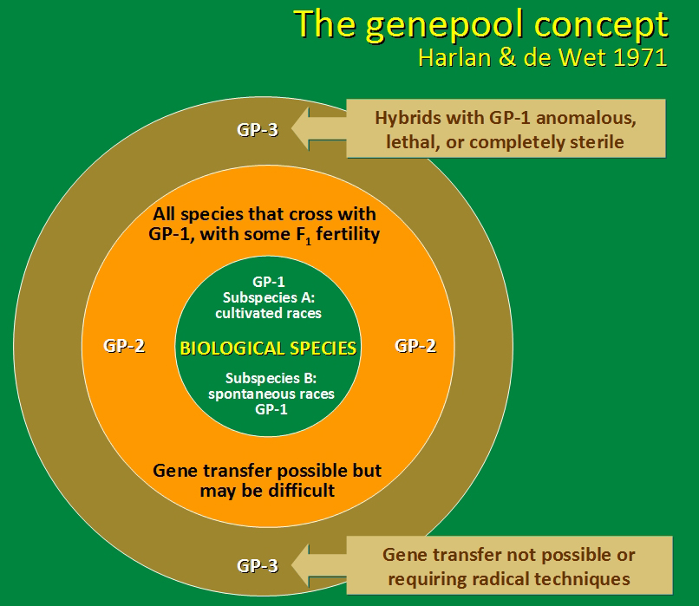
Introduction
Objectives
Materials and Methods
Results
Conclusion
b. Crop gene pool methodology
Two approaches to identify the relatedness degree of CWR to crops.
i. The genetic approach, Gene Pool Concept (Harlan & de Wet., 1971).

Slide 7
ii. The Taxonomic approach, Taxon Group Concept (Maxted et al., 2006)
Introduction
Objectives
Materials and Methods
Results
Conclusion
Taxon Group 1a – crop species
Taxon Group 1b – same species as crop
Taxon Group 2 – same series or section as crop
Taxon Group 3 – same subgenus as crop
Taxon Group 4 – same genus as crop
Taxon Group 5 – deferent genus but same trip
TG 4
TG 3
TG 2
TG 1B
Crop species

Slide 8
2. The Taxonomic approach; Taxon Group Concept (Maxted et al., 2006)
Taxon Group 1a
crop
Taxon Group 1b
same species as crop
same series or section as crop
Taxon Group 2
Taxon Group 3
same subgenus as crop
same genus as crop
Taxon Group 5
different genus to the crop
Taxon Group 4

Slide 9
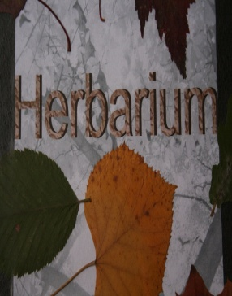





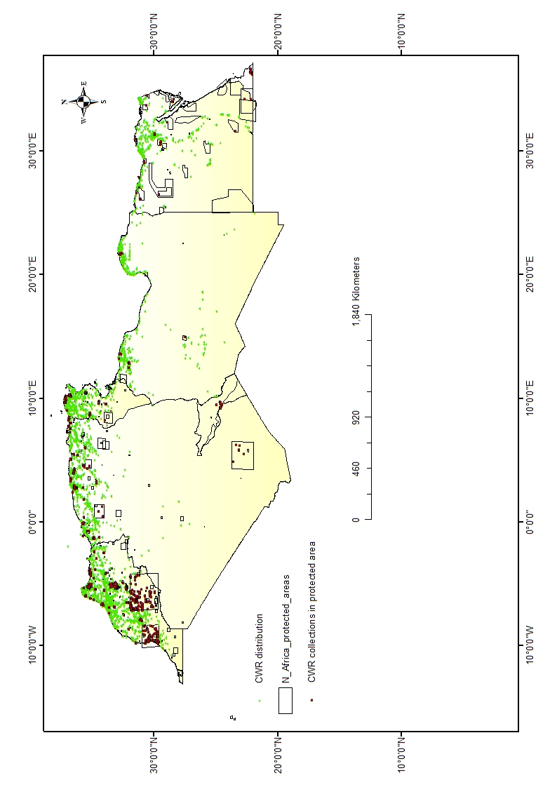
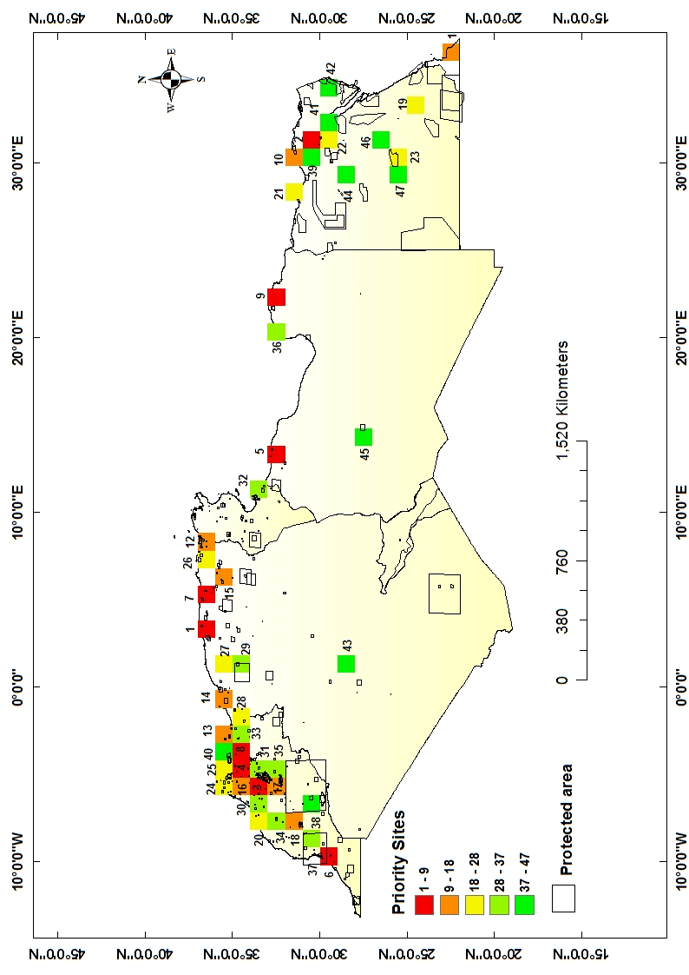
2-Ecogeographic survey and Gap Analysis Methodology
Introduction
Objectives
Materials and Methods
Results
Conclusion
Information Gathering
Georeferencing
Model distributions
Determine gaps in collections
Make collecting recommendations

Slide 10
Introduction
Objectives
Materials and Methods
Results
Conclusion
1. CWR inventory:
North Africa CWR Checklist
(6561 taxa)
Economic value, and Gene Pool or Taxon Group concept
(IUCN, 2001) red list criteria.
Socio-economic importance (275 taxa)
Threatened CWRs (39 taxa)
North Africa priority CWR (314 taxa)
North Africa priority CWR

Slide 11
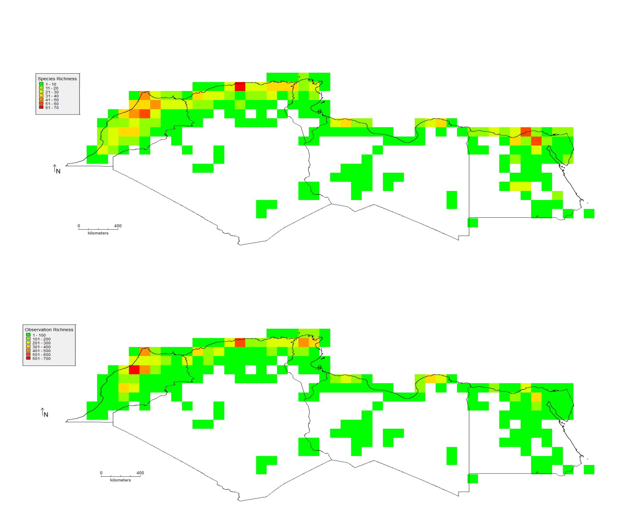
Introduction
Objectives
Materials and Methods
Results
Conclusion
Species richness of priority CWR for conservation in North Africa. Grids size (111x 111 km)
Observation richness of priority CWR for conservation in North Africa. Grids size (111x 111 km)

Slide 12
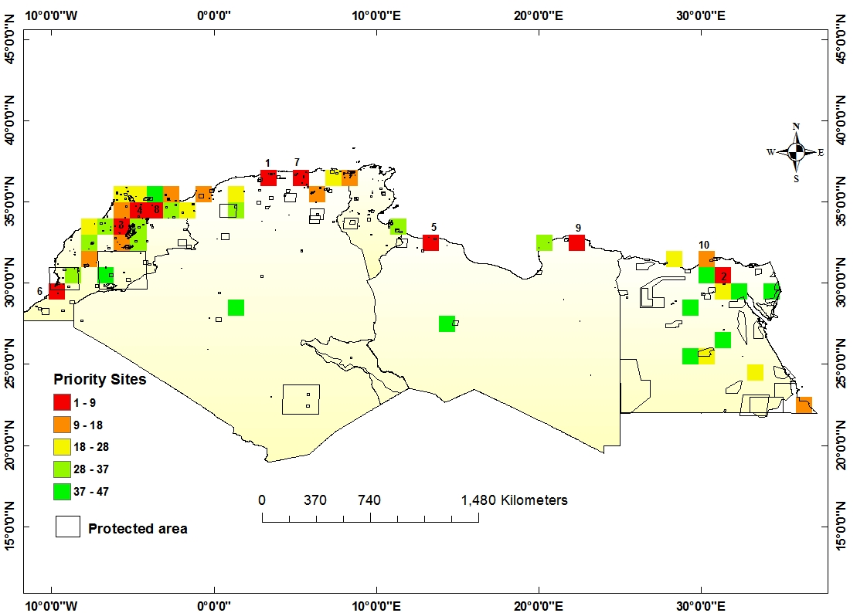
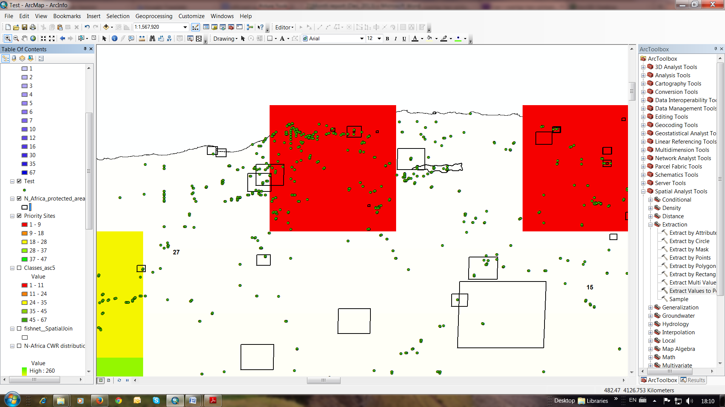
Introduction
Objectives
Materials and Methods
Results
Conclusion
Complementary areas sequence: Priority sites for conserving priority CWR of North Africa at 111 x 111 Km grid cells.

Slide 13
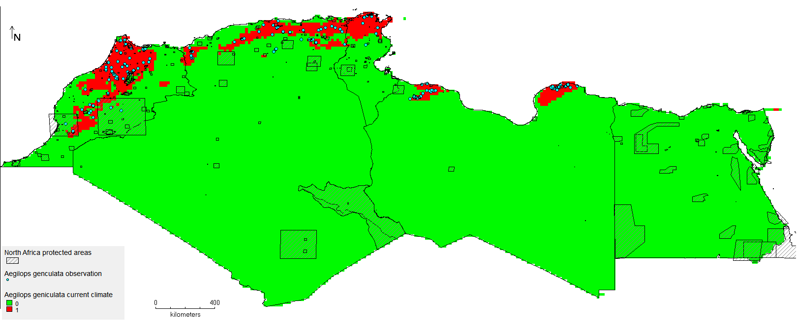

A
B
Aegilops genculata modelled distribution with current climate (A) and future climate under CCM3 model (B) using Maxent.

Slide 14
Introduction
Objectives
Materials and Methods
Results
Conclusion
To conclude:
North Africa is a hot spot of some globally important crop wild relatives, yet so far there is limited available data and no strategies for their conservation in the region.
CWR checklist contain 6561 taxa and 314 were given priority using the selected criteria.
Gap analysis revealed that 70% of the priority taxa are not integrated in any ex situ conservation program, while 51% are not represented in any in situ conservation, therefore, they are in high priority for conservation
Urgent threat assessment should be undertaken where only leas than 1% of CWR in the region assessed as threatened under IUCN red list
Approximately 47 priority sites are identified for germplasm collection and genetic reserve establishment.

Slide 15
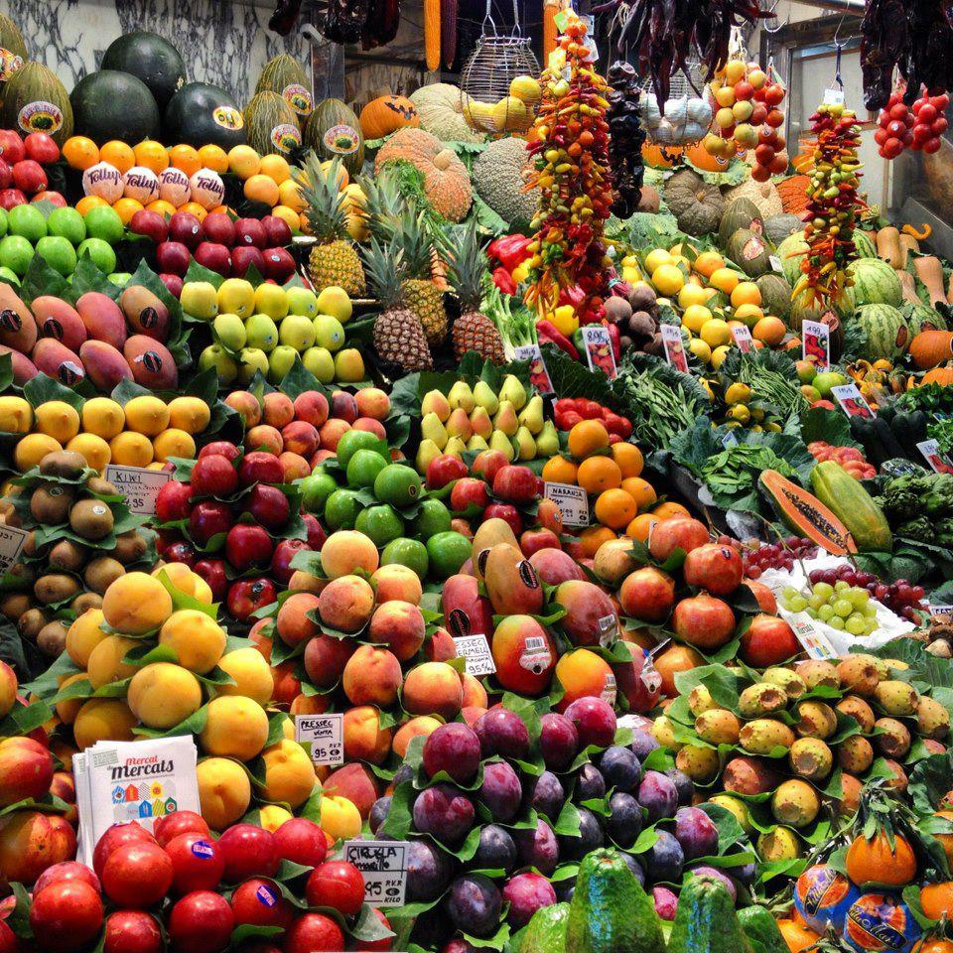
Thank you

